Slide 1


Silicon Flatirons 2020
  REGAN A. SMITH
  General Counsel
    and Associate Register of Copyrights
  United States Copyright Office
  March 5, 2020

Slide 2
WHAT IS COPYRIGHTABLE?
Originality has two parts:
Independent Creation
Minimal Degree of Creativity
§ 202.1 Material not subject to copyright.
The following are examples of works not subject to copyright and applications for registration of such works cannot be entertained:
(a) Words and short phrases such as names, titles, and slogans; familiar symbols or designs; mere variations of typographic ornamentation, lettering or coloring; mere listing of ingredients or contents;
(b) Ideas, plans, methods, systems, or devices, as distinguished from the particular manner in which they are expressed or described in a writing;
(c) Blank forms, such as time cards, graph paper, account books, diaries, bank checks, scorecards, address books, report forms, order forms and the like, which are designed for recording information and do not in themselves convey information;
(d) Works consisting entirely of information that is common property containing no original authorship, such as, for example: Standard calendars, height and weight charts, tape measures and rulers, schedules of sporting events, and lists or tables taken from public documents or other common sources.
(e) Typeface as typeface.
“[C]opyright protects only those constituent elements of a work that possess more than a de minimis quantum of creativity.”
– Feist Publ’ns, Inc. v. Rural Tel. Serv. Co., 499 U.S. 340, 363 (1991).

Slide 3
MUSICAL WORKS AND SOUND RECORDINGS
Two distinct works of authorship:
Musical work – underlying composition created by the songwriter or composer, with any accompanying lyrics
Sound recording – particular performance of the musical work that has been fixed in a recording medium such as a CD or digital file (i.e., a “phonorecord”)
composition/
musical work
performance/
sound recording

Slide 4
DEPOSIT ISSUE – COMPLETE COPY
§ 408. Copyright registration in general
(b) Deposit for Copyright Registration. – Except as provided by subsection (c), the material deposited for registration shall include –
(1) in the case of an unpublished work, one complete copy or phonorecord;
(2) in the case of a published work, two complete copies or phonorecords of the best edition;
(3) in the case of a work first published outside the United States, one complete copy or phonorecord as so published;
(4) in the case of a contribution to a collective work, one complete copy of phonorecord of the best edition of the collective work.
The Office requires a complete copy of the work to accompany an application for registration.
37 C.F.R. § 202.20

Slide 5
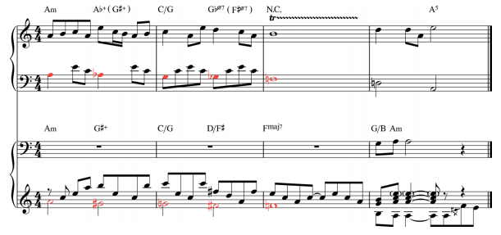
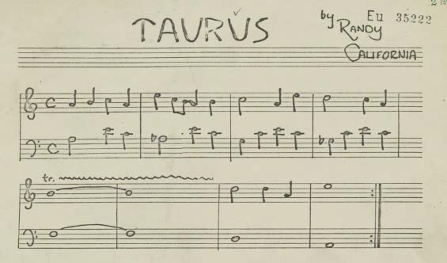
DEPOSIT ISSUE – SCOPE
White-Smith doctrine: to constitute a “copy,” there
must be “a written or printed record of it in intelligible notation.” White-Smith Music Publ’g Co. v. Apollo Co., 209 U.S. 1, 17–18 (1908).
A phonograph is not registerable as it is not a copy.
37 C.F.R. §202.8(b) (1964)
Copyright Office’s 1961 Report of the Register: Office acknowledged “transcription into written notation required for deposit is difficult and expensive.”
1976 Act:
Deposit for Copyright Registration.
In the case of an unpublished work, one complete copy or phonorecord
Stairway
Taurus

Slide 6
DEPOSIT ISSUE – SOLUTION = REGISTER THE REMAINDER
“While it is true that the ‘lead sheets’ often deposited in the case of such unpublished musical works did not capture all potentially copyrightable elements embodied in recordings of these songs, the proper solution is for an author to register the remainder material as a different version of the work from the lead sheet, not for the court to expand the contours of a copyright registration beyond the scope of the deposit.”
– Copyright Office’s Amicus participation in Skidmore v. Led Zeppelin, Nos. 16-56057 & 16-56287 (9th Cir.) at 4.

Slide 7
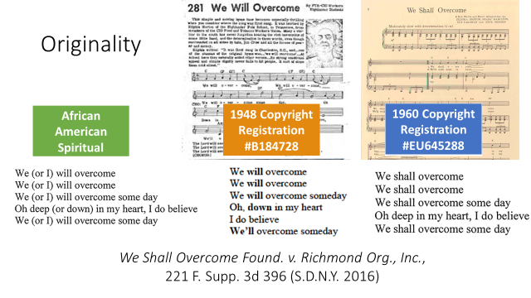
WE SHALL OVERCOME FOUND. V. RICHMOND ORG., INC.
“The one-word change did not create a distinguishable variation. Any finding to the contrary would substantially expand the scope of protection for derivative works.”
Substituting the word “shall” with “will” is “quintessentially trivial”

Slide 8
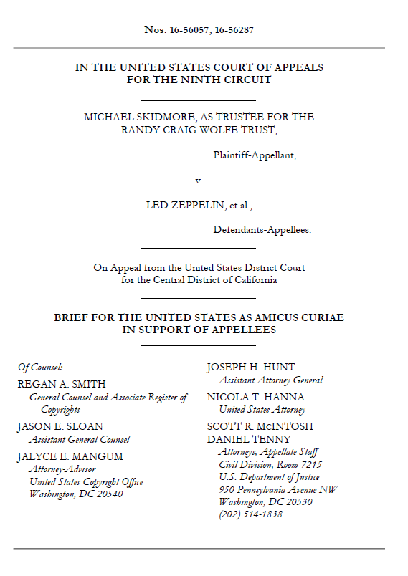
ORIGINALITY – SKIDMORE V. LED ZEPPELIN
Whether basic musical elements, such as a chord or chromatic scale, may ever be copyrightable, and whether the selection and arrangement of a small number of such elements can be entitled to only “thin” copyright protection
“Standard elements such as arpeggios (i.e., notes of a chord played in sequence) or chromatic scales can never be independently protectable under copyright law.”
Selection and arrangement of uncopyrightable elements can be protectable, “but such arrangements do not provide a copyright in the standard elements themselves.”
Thin copyright – applies when “author’s original contribution consists only of an arrangement of a small number of conventional elements”

Slide 9
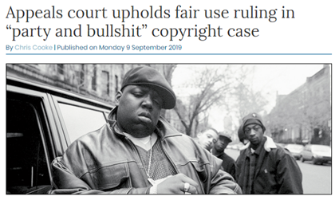
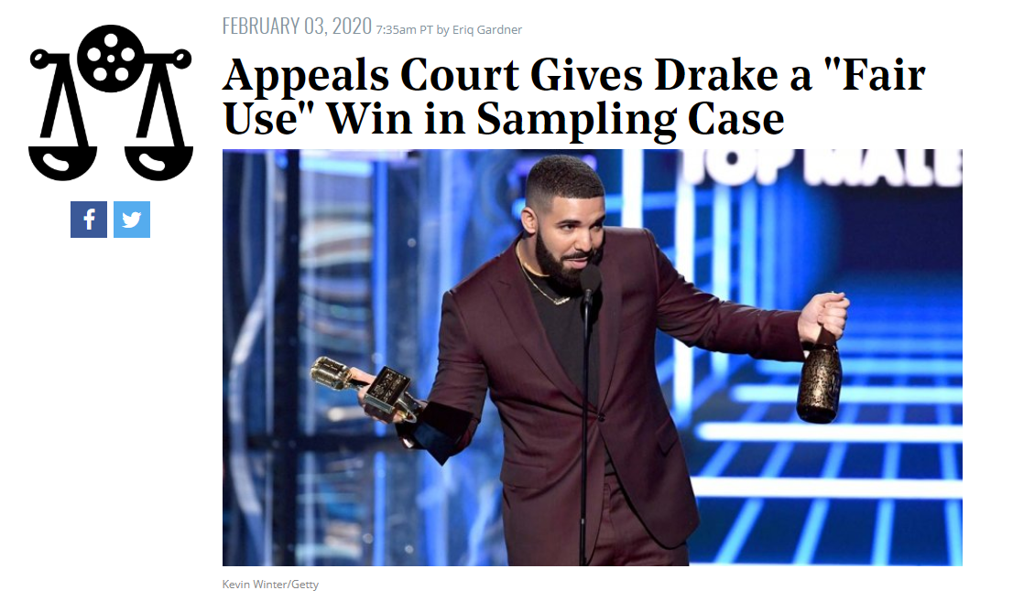
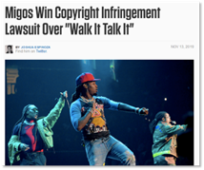
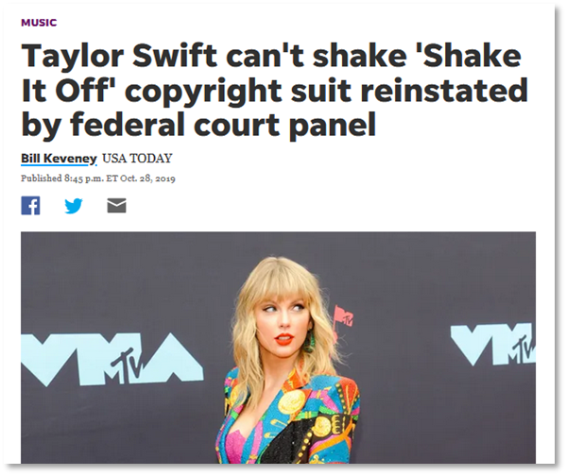
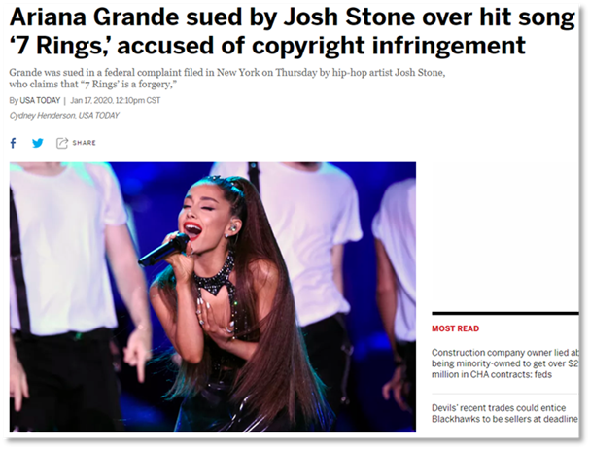
INFRINGEMENT – MUSICAL WORKS
Lyrics

Slide 10
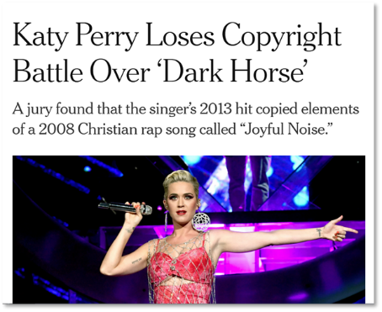
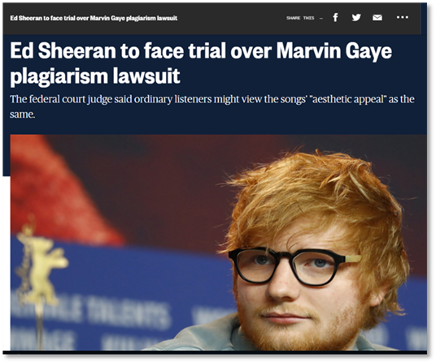
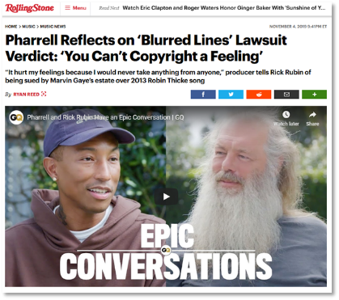
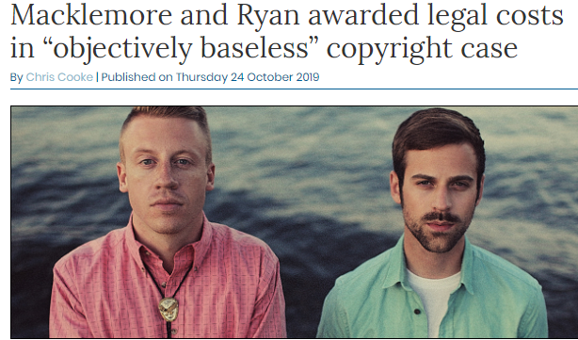
INFRINGEMENT – MUSICAL WORKS
Musical Elements

Slide 11
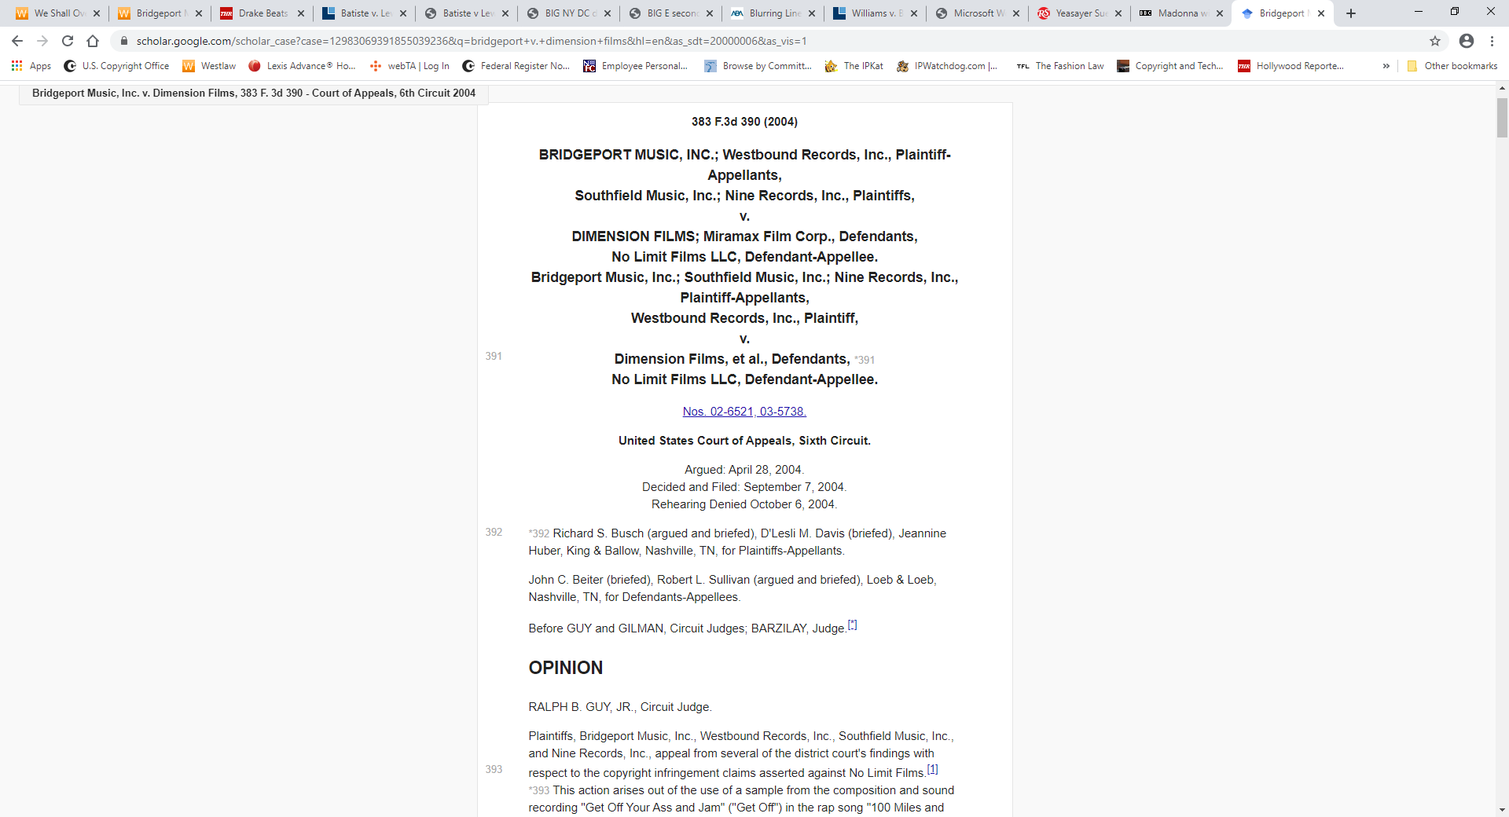
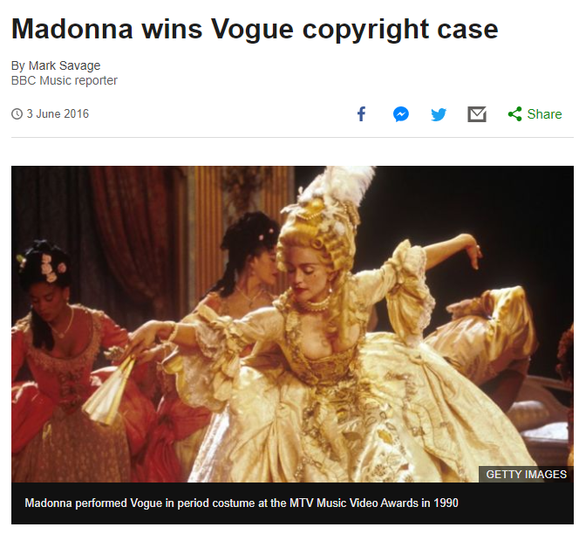
INFRINGEMENT – SOUND RECORDING
Bridgeport Music, Inc. v. Dimension Films – holding that there is no de minimis standard for sampling.
“any copying of quarter-note single horn hit, full measure containing rests, and double horn hit was de minimis, and thus was not copyright infringement.” – VMG Salsoul, LLC v. Ciccone

