Slide 1
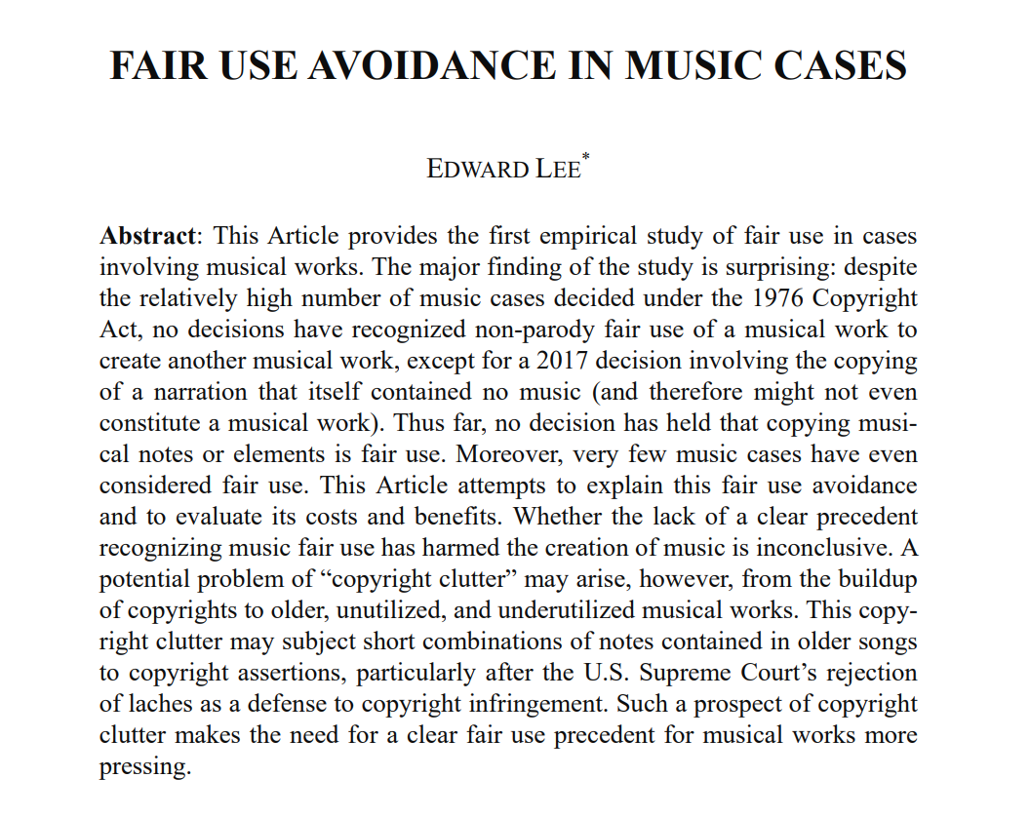
2018 study

Slide 2
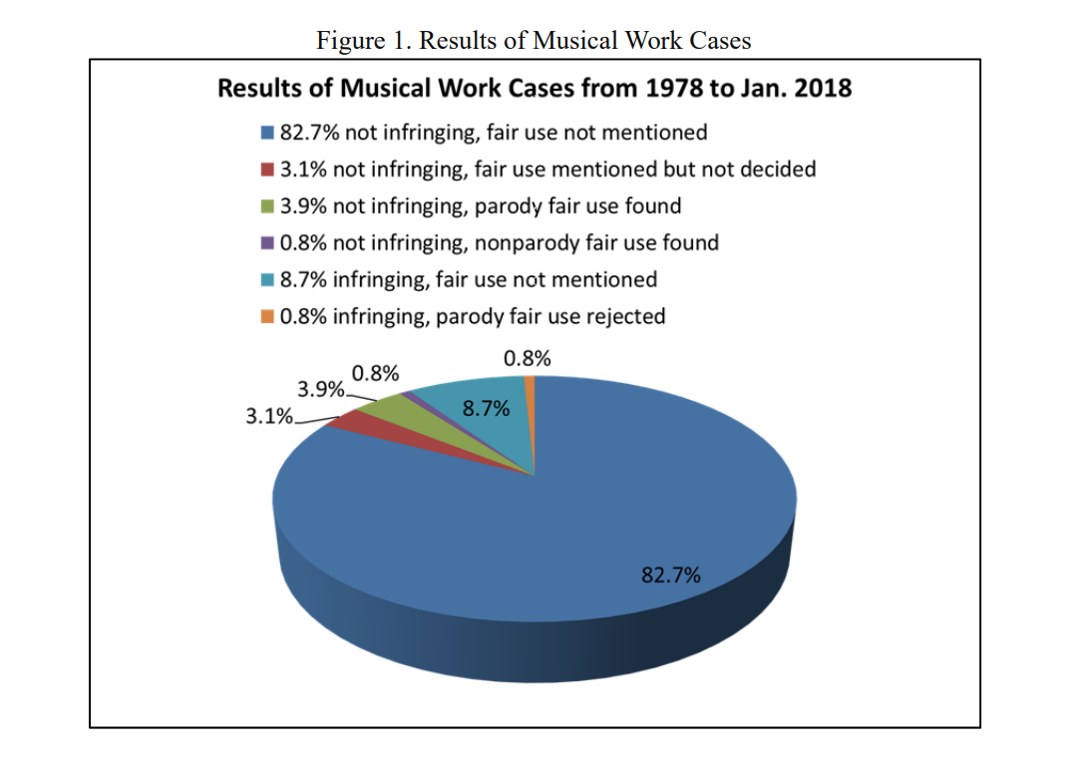
2018 study

Slide 3
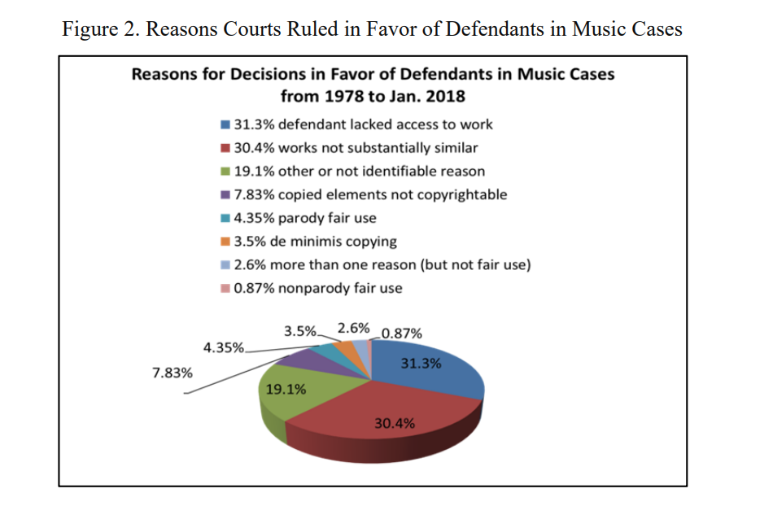
2018 study

Slide 4
Fair use – typically not pursued outside of parody

Slide 5
2020 study

Slide 6
Experimental Study - Design
Online instrument via Amazon Turk
n=503 subjects
Each person decided 4 cases, same facts with…
Music case A v. B Music case C v. D
(low similarity) (high similarity)
GTGIU + BL HSF + MSL
-substantial similarity -substantial similarity
-fair use -fair use

Slide 7
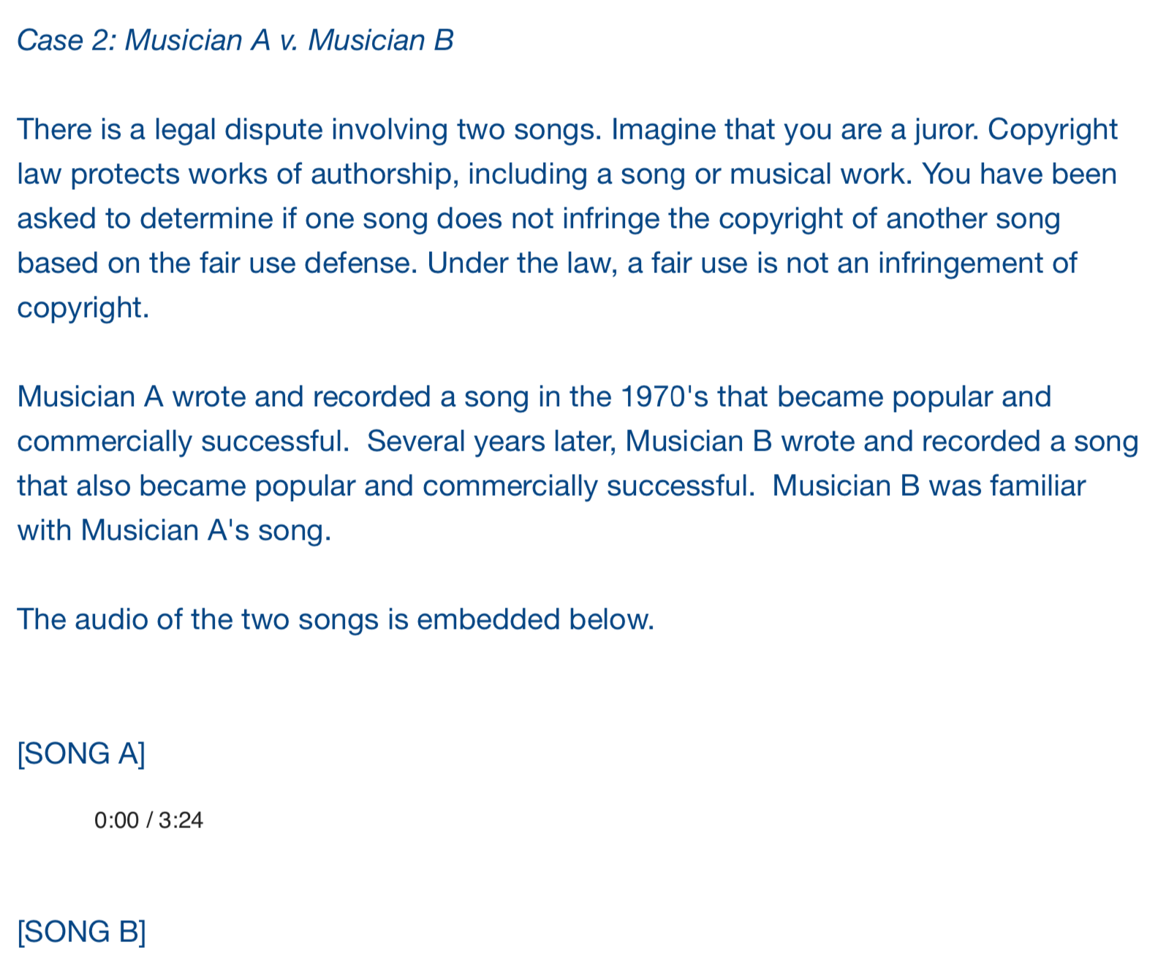
Facts

Slide 8
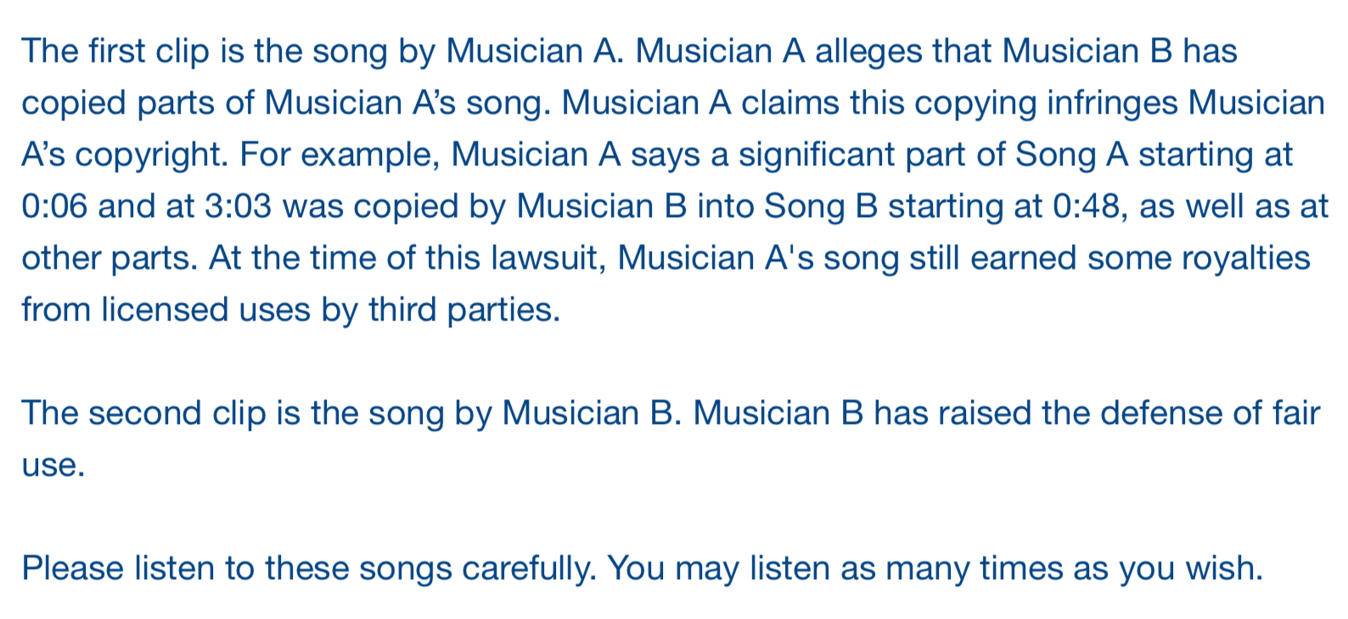
Facts

Slide 9
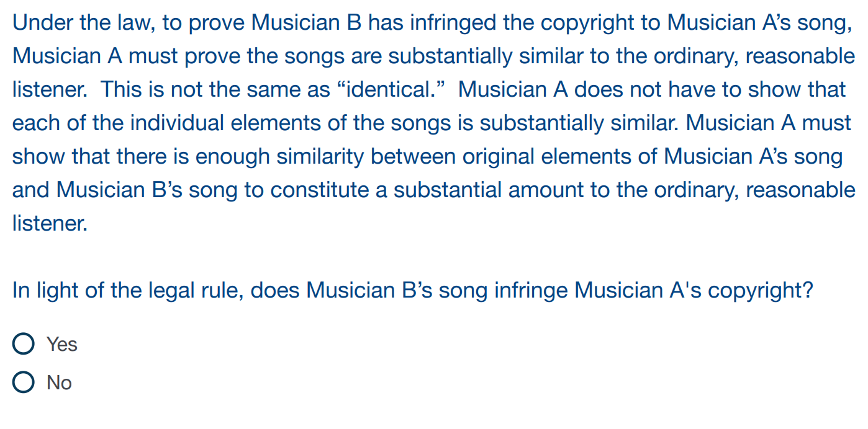
Substantial similarity instruction

Slide 10
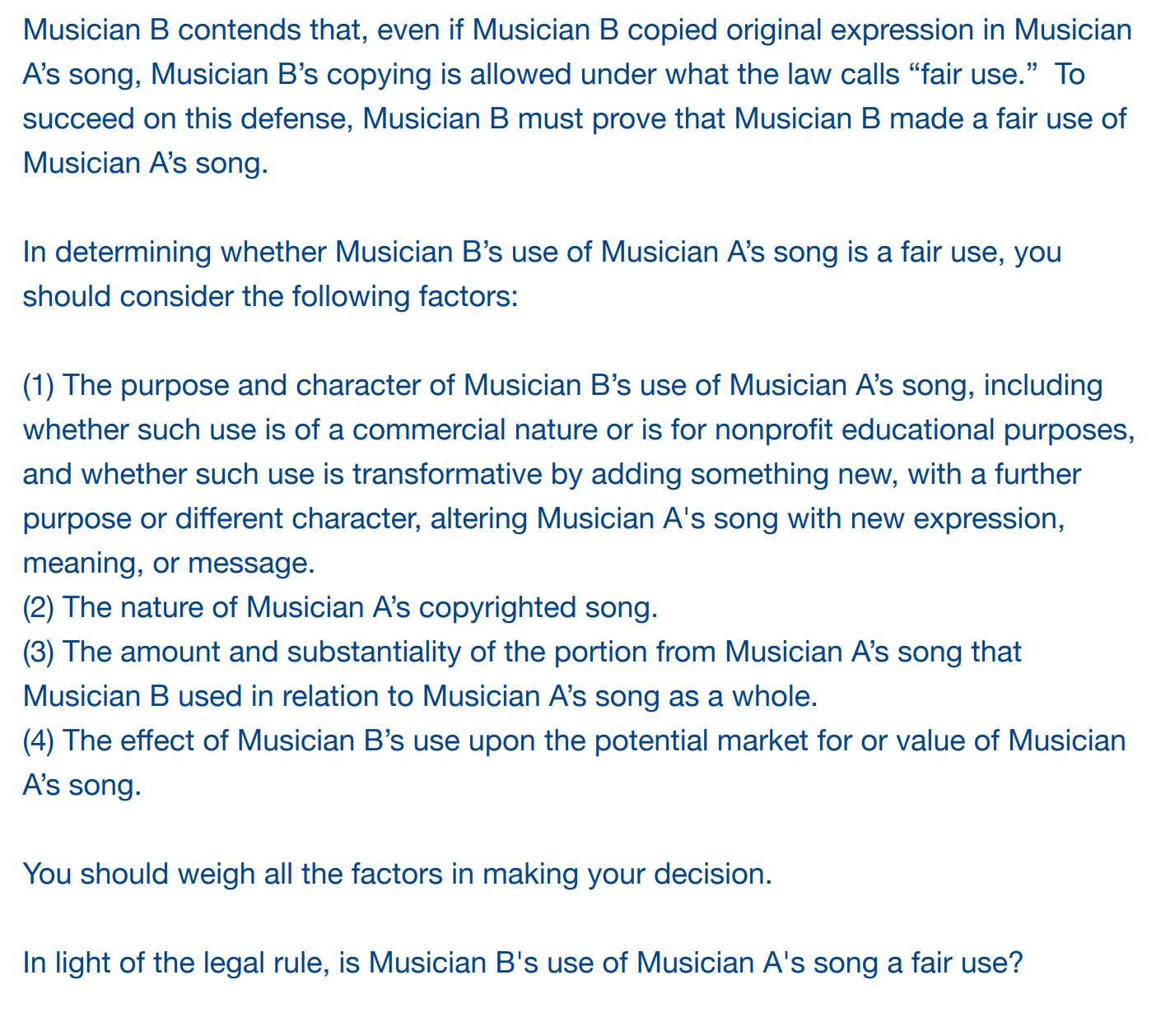
Fair use
Instruction

Slide 11
Finding 1: fair use matters

Slide 12
fair use matters
fair use matters

Slide 13
Finding 1a: fair use more confidence

Slide 14
Case | Legal Rule | N | N Finding No Liability / Potential Liability | Mean Confidence Liability or Potential Liability (Standard Deviation) | Mean Confidence No Liability (Standard Deviation) | Significance
A v. B | Substantial Similarity | 503 | 197/306 | 7.18 (1.64) | 7.38 (1.86)
A v. B | Fair Use | 503 | 167/336 | 6.85* (1.91) | 7.39 (1.84) | .003
C v. D | Substantial Similarity | 503 | 299/204 | 7.29 (1.75) | 7.32 (1.83)
C v. D | Fair Use | 503 | 233/270 | 6.83** (2.05) | 7.30 (1.84) | .006
Less confidence only when rejecting fair use

Slide 15
Finding 2: knowledge matters

Slide 16
Knowledge
Matters
Inverse
relationship

Slide 17
Knowledge
Matters
Inverse
relationship

Slide 18
People with Music or Legal Knowledge
1. Substantial similarity (liable) – more likely
2. Fair use (not liable) – more likely
= greater sensitivity to change in legal rules
(or to music)

Slide 19
Comments?
elee@kentlaw.iit.edu

