Slide 1

Probabilistic Risk Assessment: The Shift to More Realistic Risk Decision-Making
Risk Assessment in Spectrum Policy
Silicon Flatirons Center Conference
October 23, 2015
Gary E. Marchant, Ph.D., J.D.
gary.marchant@asu.edu

Slide 2
What is Risk Assessment?
Risk assessment is a process where information is analyzed to determine if a potential hazard might cause harm in specific real-world scenarios
Paraphrased from “Risk Assessment in the Federal Government” (National Research Council, 1983)

Slide 3
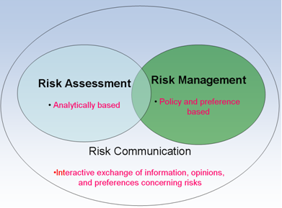

Slide 4
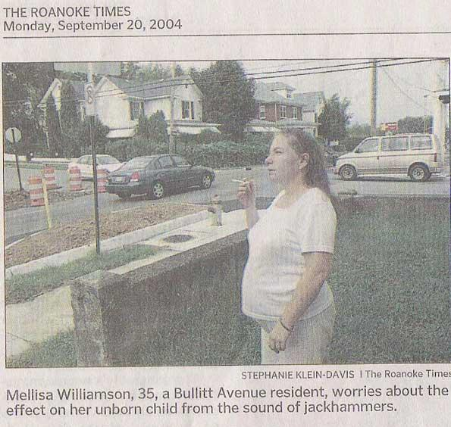
Why We Need Risk Assessment

Slide 5
Two Types of Probabilistic Risk Assessment
Event Tree/Fault Tree Analysis
Multiply probabilities along fault tree to give specific probabilities for specific accident events
Mostly uses deterministic inputs
Provide probability distribution for each input and output

Slide 6
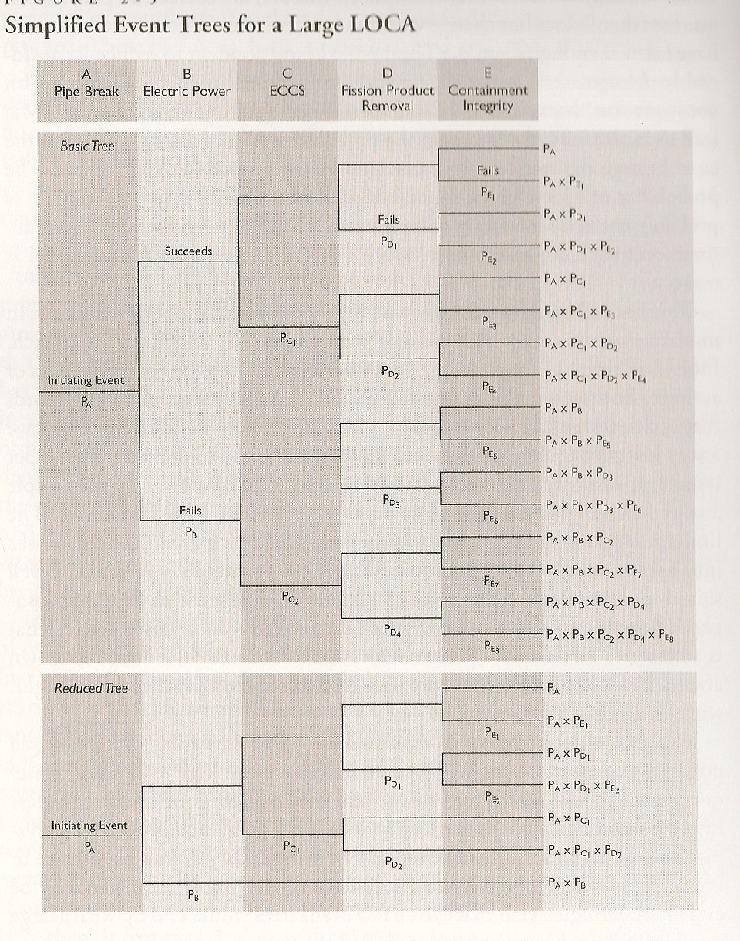
Event Tree Probabilistic
Risk Assessment
From Rasmussen (1975)
Nuclear Reactor Safety Study

Slide 7
Risk Assessments Always Involve Variability and Uncertainty
Variability: refers to the certainty that
different members of a population will have different values (inter-individual variability)
values will vary over time for a given member of the population (intra-individual variability)
Uncertainty: refers to lack of knowledge regarding
True value of a fixed but unknown quantity
True population distribution for variability

Slide 8
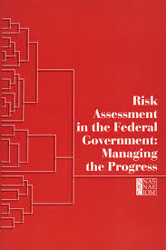
National Academy of Sciences: The “Red Book” (1983)
Regulatory agencies must address uncertainty and variability inherent in risk assessment
When science cannot provide answers, agencies should adopt “inference options” to fill gaps
These inference options can serve as defaults in risk assessment in absence of actual data

Slide 9
EPA Response to Red Book
EPA responded to Red Book by adopting a series of risk assessment guidelines in the 1980s (e.g., Carcinogenicity Risk Assessment Guidelines, Exposure Assessment Guidelines)
Guidelines defined series of default assumptions that would be used in absence of real data
Default assumptions tended to be “conservative” – plausible upper bound – consistent with Agency’s public health/protective mission

Slide 10
EPA’s “Deterministic” Risk Assessments
“The Agency has developed simplified approaches to characterize risks associated with such complex assessments through the use of point estimates for model variables or parameters. Such an approach typically produces point estimates of risks (e.g., 10‐5 or a lifetime probability of cancer risk of one individual in 100,000). These often are called “deterministic” assessments. As a result of the use of point estimates for variables in model algorithms, deterministic risk results usually are reported as what are assumed to be either average or worst‐case estimates. They do not contain any quantitative estimate of the uncertainty in that estimate, nor report what percentile of the exposed population the estimate applies.” (EPA, 2014)

Slide 11
EPA – Use of Defaults
“Deterministic risk assessment (DRA) often is considered a traditional approach to risk analysis because of the existence of established guidance and procedures regarding its use, the ease with which it can be performed, and its limited data and resource needs. The use of defaults supporting DRA provides a procedural consistency that allows for risk assessments to be feasible and tractable. Decision makers and members of the public tend to be relatively familiar with DRA, and the use of such an approach addresses assessment‐related uncertainties primarily through the incorporation of predetermined default values and conservative assumptions. It addresses variability by combining input parameters intended to be representative of typical or higher end exposure (i.e., considered to be conservative assumptions).” (EPA, 2014)

Slide 12
Use of “Conservative” Risk Assessment Defaults
Government generally errs on the side of safety by adopting “conservative” assumptions – intended to be plausible worst-case estimates
e.g., exposure at fence line of a facility - used to assume 24 hours per day for 70 years
Erring on side of safety not per se unreasonable – we do generally favor lives over dollars
“The greater the uncertainty about a given effect, the more likely it is to be overestimated.” Nichols & Zeckhauser
But problem - when add together so many safety factors – get compounding effect that may grossly exaggerate risk
95% %ile x 95%ile ≠ 95%ile
e.g., formaldehyde - endogenous FH production (58 g/day) should produce over 37 fatal cancers in each of us
Waddell, Drug Metabolism Reviews 28:181, 191 (1996)

Slide 13
The Perils of Prudence
“At the EPA, … the agency’s administrator and political deputies… are rarely told the range of plausible estimates, or the most likely estimate, of the risk they are asked to regulate. Instead they are usually only told the up “plausible upper bound” estimate, a term of art indicating that the actual risk is almost certain to be no higher.”
Nichols & Zeckhauser, The Perils of Prudence (1986)

Slide 14
Criticisms of EPA Risk Assessments
OMB, NRC, and EPA SAB all criticized EPA risk assessments in the late 1990s and 2000’s:
EPA intermingles policy judgments within the scientific assessment of risk
Risk assessments rely on conservative (“worst case”) assumptions that distort outcomes and yield estimates that grossly overstate risk
Risk assessments fail to acknowledge the presence of considerable uncertainty

Slide 15
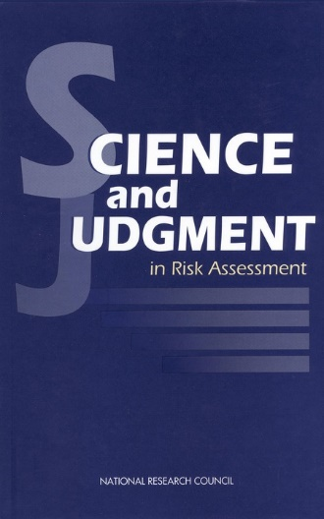
National Academies of Science: “Blue Book” (1994)
“Uncertainty analysis is the only way to combat the ‘false security of certainty,’ which is caused by a refusal to acknowledge and [attempt to]quantify the uncertainty in risk predictions.”

Slide 16
William Ruckelshaus (1984)
“[W]e must insist on risk calculations being expressed as distribution of estimates and not as magic numbers that can be manipulated without regard to what they really mean. We must try to display more realistic estimates of risk to show a range of probabilities. To help us to this we need new tools for quantifying and ordering sources of uncertainty and for putting them in perspective.”

Slide 17
Alternatives
Late 1990’s – EPA concedes upper worst bound approach is flawed, starts considering changes:
More reasonable worst case assumptions – instead of assuming 24/day chemical exposure for 70 years, assume 2- 6 hr/day exposure for 10-35 years
Provide range of outcomes
Mean, “best estimate,” or expected value approach
Probabilistic risk assessment

Slide 18
What is Probabilistic Risk Assessment?
“PRA is a group of techniques that incorporate variability and uncertainty into the risk assessment process. It provides estimates of the range and likelihood of a hazard, exposure or risk, rather than a single point estimate. It can provide a more complete characterization of risks, including uncertainties and variability, to protect more sensitive or vulnerable populations and lifestages. The information obtained from a PRA can be used by decision makers to weigh the risks of decision alternatives, or to invest in research with the greatest impact on risk estimate uncertainty.” (EPA, 2014)

Slide 19
PRA Methods (EPA)?
Monte Carlo analysis
Other statistical models (unspecified)
Sensitivity analysis
Expert elicitation

Slide 20
What is Monte Carlo Analysis?
It is a tool for combining distributions, and thereby propagating more than just summary statistics
Numerous inputs determine output
eg: Risk = probability × consequence
For each input, use either a probability distribution, multi-choice variable, or binary choice
Computer draws randomly from each input, calculates output
Repeats this sampling thousands of times
This set of results is displayed as a new, combined distribution

Slide 21
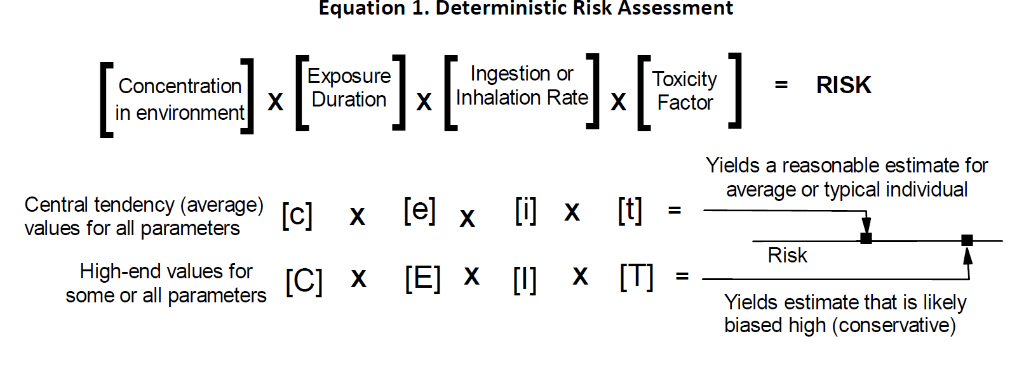
Source: EPA 2014

Slide 22
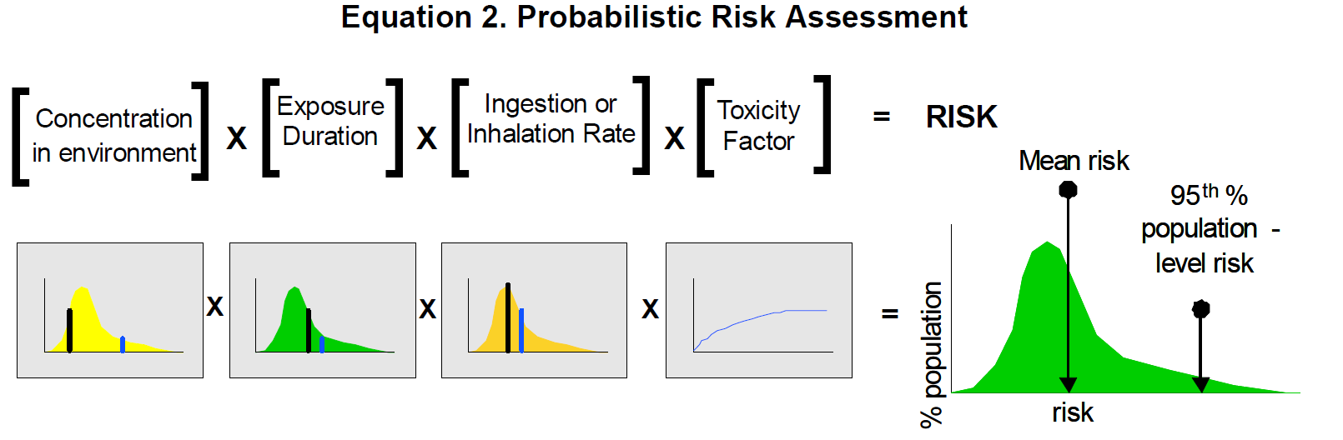
Source: EPA 2014

Slide 23
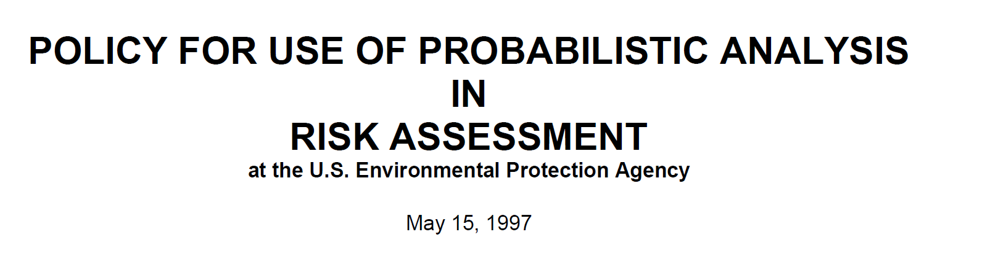

Slide 24
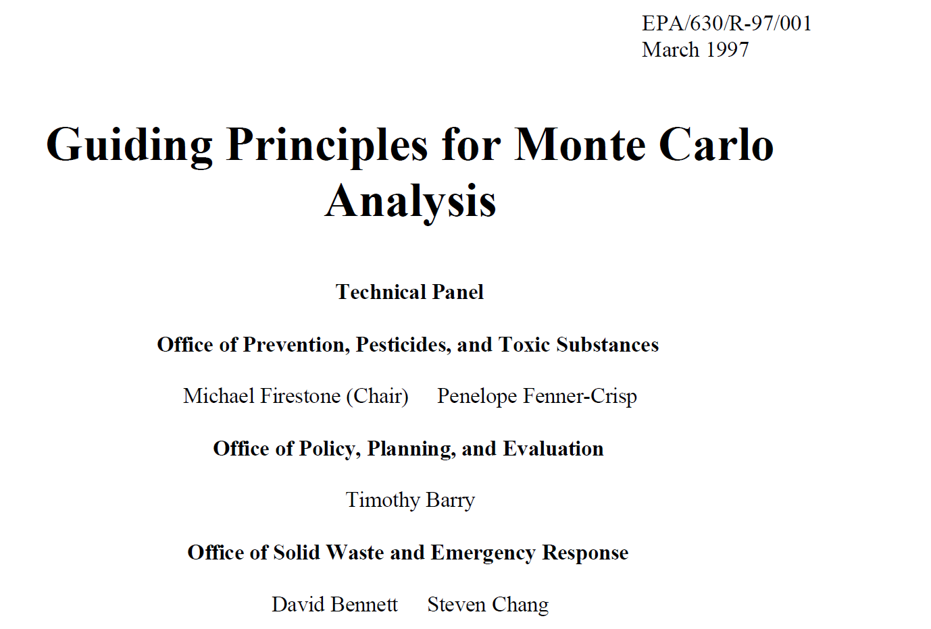

Slide 25
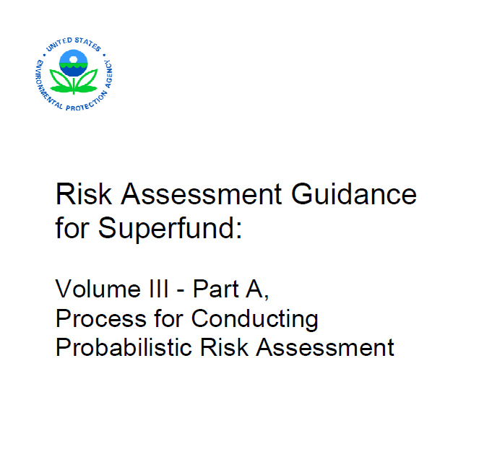
2001

Slide 26
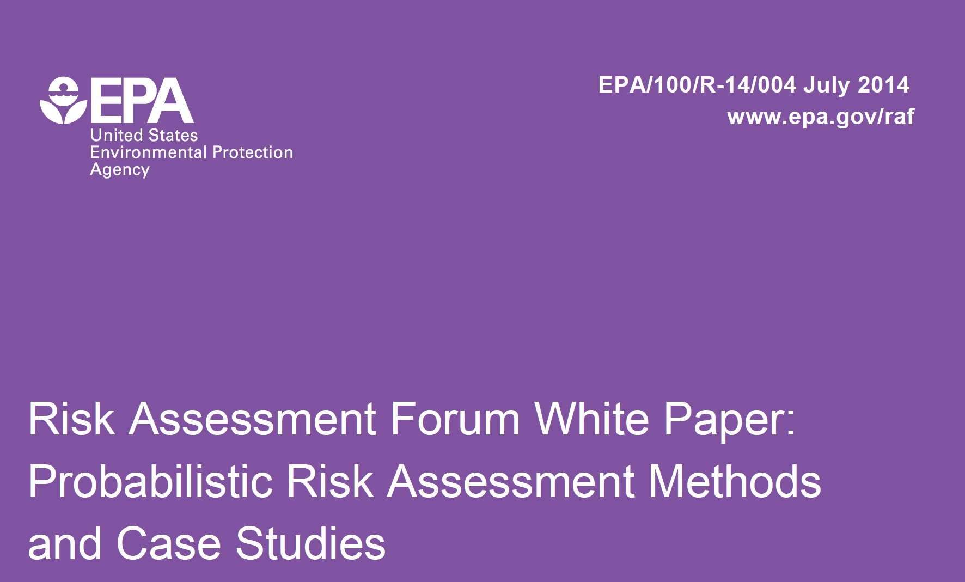

Slide 27
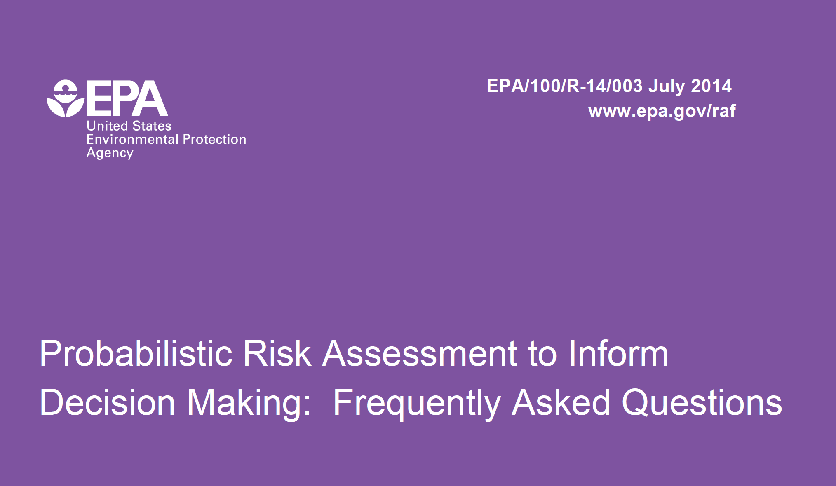

Slide 28
EPA Endorsement of PRA (2014)
“Probabilistic risk assessment (PRA) is one way to characterize the uncertainty associated with any risk assessment. As part of a decision analysis, the enhanced use of PRA and characterization of uncertainty would allow EPA decision‐makers opportunities to assess uncertainty pertaining to its effect on decisions and explore the defensibility of the available risk management options through a more robust and transparent process. Most often, risk managers want to know if better understanding of uncertainties might support a different decision alternative or provide further support for the selected decision.”

Slide 29
Benefits of PRA
Provides decision-maker with a more realistic and robust representation of variability and uncertainty
Provides greater transparency to risk managers and stakeholders
Eliminates distorting effect of compounding conservative default values
Shifts judgment about how to handle uncertainty to risk manager from risk assessor
“By understanding and explicitly accounting for uncertainties underlying a decision, EPA can estimate formally the value of gathering more information” (EPA, 2014)

Slide 30
EPA: Challenges of PRA
“A clear institutional understanding of how to incorporate the results of probabilistic analyses into decision making is lacking;
PRA typically requires a different skill set than used in current evaluations, and limited resources (staff, time, training or methods) to conduct PRA are available;
Communicating probabilistic analysis results and the impact of those results on the decision/policy options can be complex;
Communication with stakeholders is often difficult and results in the appearance of regulatory delays due the necessity of analyzing numerous scenarios using various models;
PRA complicates decision making and risk communication in instances where a more comprehensive characterization of the uncertainties leads to a decrease in clarity regarding how to estimate risk for the scenario under consideration.”
EPA (2014)

Slide 31
Communicating Results of PRA
“Communicating the results of probabilistic risk assessment requires particular attention.... Risk assessors are responsible for sharing information on probabilistic results so that risk managers have a clear understanding of quantitative assessments of uncertainty and variability and how this information will affect the risk management decision. Clear communication between the risk assessment team and the decision maker is essential in aiding the decision maker’s understanding and use of the results from the probabilistic risk assessment.
EPA, Framework for Human Health Risk Assessment to Inform Decision-Making 45 (2014)

Slide 32
More on Communicating PRA
“The lack of familiarity with PRA presents a challenge in effectively presenting results to decision makers, stakeholders and the public. Many view PRA as a highly technical discipline that uses sophisticated mathematics and requires extensive training to apply and understand. Single point estimates are easier to grasp for most people, based in part on familiarity with this approach over the history of EPA. Although some people initially have difficulty interpreting probability distributions of values, everyone has a common baseline experience with probability, uncertainty and variability from everyday life (e.g., weather forecasting, odds of winning a lottery), and this experience could be used to frame the discussion of results. It is not necessary to understand the underlying mathematics or even to include results as full distributions. Results can be distilled down to the critical essence or decision‐meaningful input of interest.” (EPA 2014)

Slide 33
Life is Messy: Deal with It!
“It is the mark of an instructed mind to rest satisfied with the degree of precision which the nature of the subject permits and not to seek an exactness where only an approximation of the truth is possible.”
-Aristotle

Slide 34
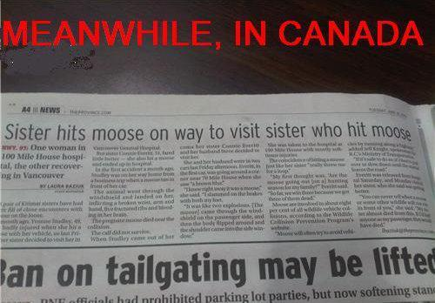
Risk is Messy…

Slide 35
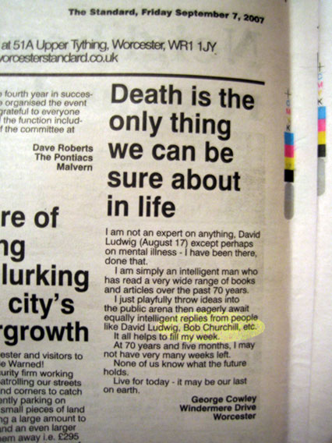
Conclusion
“Life really is about risk and it ends badly.”
Senator Patrick Moynihan

