Slide 1
Risk Analysis in Engineering and Public Policy
Paul Fischbeck
Department of Engineering and Public Policy
Department of Social and Decision Sciences
Carnegie Mellon University

Slide 2
Introduction
Risk is inherent in most any activity
  What is really known?
  Add human behavior to mix
  Regardless, decisions must be made.
Simple definition of risk
  Risk = Probability X Consequence
Possible problems?
  It equates a rare event with relatively high consequences with a more common event with relatively modest consequences.
  It equates risk with expected outcome potentially obscuring information that is of interest to the decision-maker.
  Risk must be understood before it can be mitigated.
  Need a better definition to provide insights.

Slide 3
A Broader Definition of Risk
Stan Kaplan & John Garrick’s landmark paper, "On the Quantitative Definition of Risk," was the first paper published in the first issue of the Journal of the Society for Risk Analysis.
Risk is the set of triplets: R = {(s_{i}, p_{i}, x_{i})}
  s_{i} What can happen (initiating event)?
  p_{i} How likely is it to happen?
  x_{i} If it does happen, what are the consequences?
Risk is multidimensional with many possible damage measures.
Risks include costs and benefits
Nature, mechanical systems, and human/societal events
  What’s knowable and what’s reducible?

Slide 4
Reduce Risk
Reduce the likelihood of the IE “and eliminate” the consequences
  Slow down and give the lookouts binoculars to look for icebergs
  Design water-tight doors for the lower decks of your ship up to and over the waterline

Slide 5
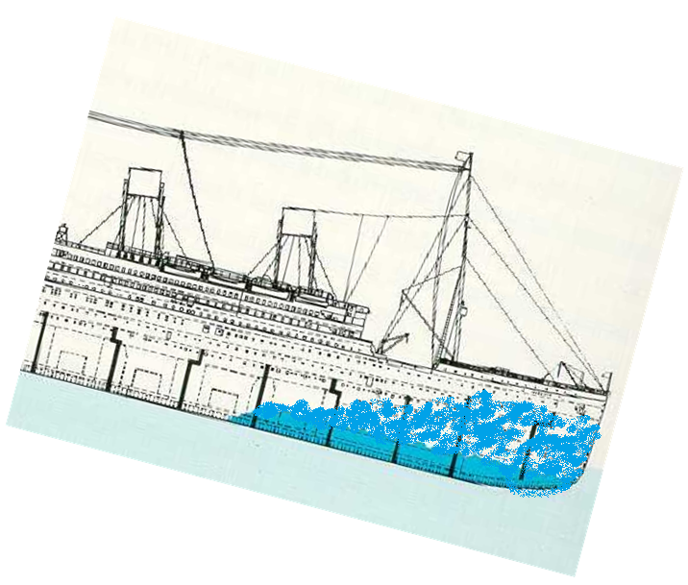
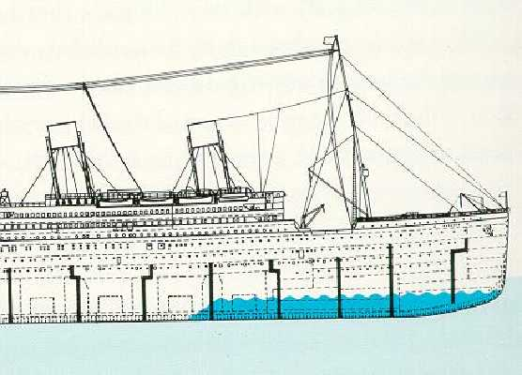
Watertight Bulkheads Went Only So Far
http://web.cuug.ab.ca/~branderr/risk_essay/

Slide 6
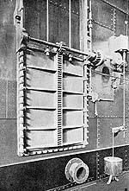
Automatic Watertight Doors
Automatic closing sensor
http://web.cuug.ab.ca/~branderr/risk_essay/

Slide 7
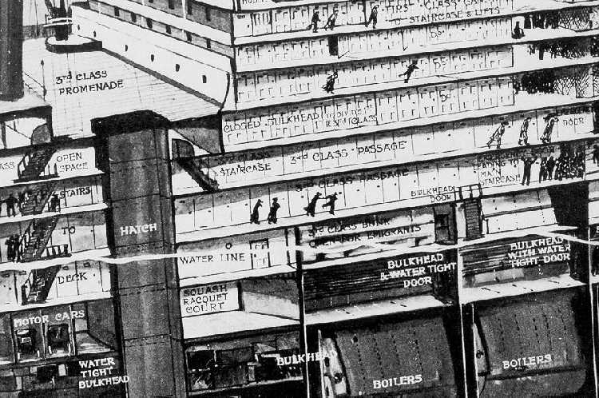
Trade-off with Passenger Comfort
http://web.cuug.ab.ca/~branderr/risk_essay/

Slide 8
Reduce Risk
Reduce the likelihood of the IE “and eliminate” the consequences
  Slow down and give the lookouts binoculars to look for icebergs
  Design water-tight doors for the lower decks of your ship up to and over the waterline
  Build a sea wall around your nuclear power plant

Slide 9
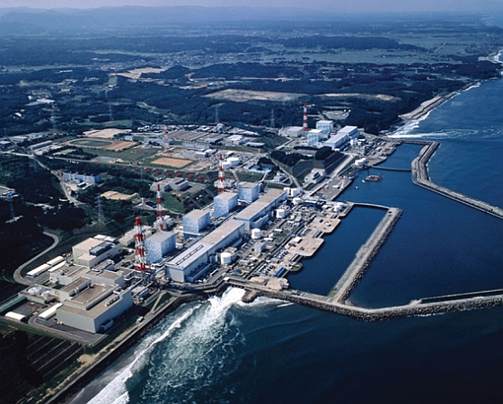
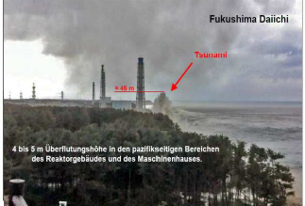
Back-up Generators in the Basement

Slide 10
Reduce Risk
Reduce the likelihood of an IE and “eliminate” the consequences
  Slow down and give the lookouts binoculars to look for icebergs
  Design water-tight doors for the lower decks of your ship up to and over the waterline
  Build a sea wall around your nuclear power plant
Prescriptive or performance-based standards
  Fire code (e.g., must have fire doors, fire sprinklers) or performance-based standards that include human behavior

Slide 11
Time to Untenability in the Living Room Given Fire-starting Location

Slide 12
Reduce Risk
Reduce the likelihood of an IE and “eliminate” the consequences
  Slow down and give the lookouts binoculars to look for icebergs
  Design water-tight doors for the lower decks of your ship up to and over the waterline
  Build a sea wall around your nuclear power plant
Prescriptive or performance-based standards
  Fire code (e.g., must have fire doors, fire sprinklers) or performance-based standards that include human behavior
  Double hull oil tankers or “equivalently safe”

Slide 13
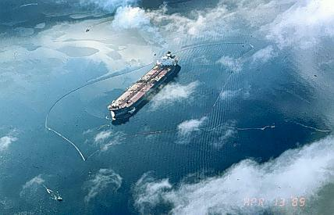
What’s the Metric of Interest?
Probability of leak given initiating event?
Amount of oil in the water?
Environmental damage given oil in the water?
Worst case spill?
What is worse: ten 1,000 barrel spills or one 10,000 barrel spill?
Multiple dimensions?

Slide 14
Equivalent in What Sense?
Threshold
Design A
Design A
Expected Size of Outflow
Expected Size of Outflow
Threshold
Design B
Design B
Probability of Outflow
Probability of Outflow
  Which is better? A design that:
  Leaks rarely, but when it does, leaks a lot
  Leaks more often but on average, not very much

Slide 15
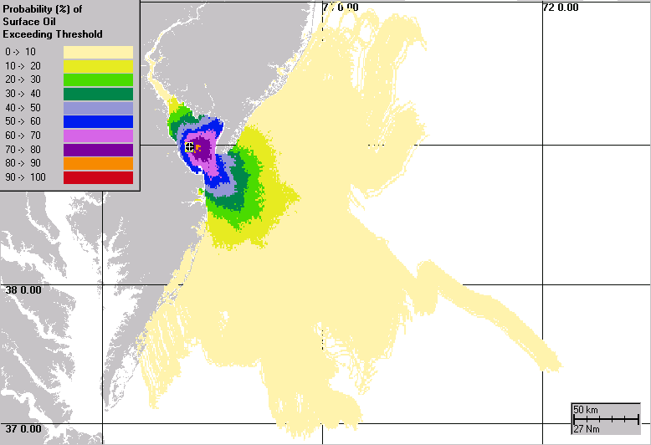
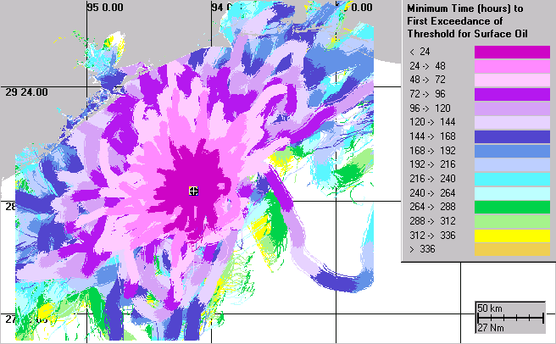
Oil Spill Impact
Spill Variables
Impact Criteria
Location
Weather
Amount
Type
Water column/Threshold
Surface/Threshold
Shore/Threshold
Clean-up/Third Party Damage
.

Slide 16
Acknowledge or Bound the Risk
Given what we don’t know, how safe is safe enough?
  Really want to be sure ….
Cancer risk from chemicals
  Mouse-to-human models
  Extrapolating cancers risks from large doses in mice to small doses in humans
  Extrapolate based on weight differences (2,000) or …?
  Large uncertainties handled through safety margins (10 to 100-fold factors)
  Adding a margin of safety?

Slide 17
Nuclear Power Plants
The poster child for probabilistic risk assessments (PRA)
Extensive fault trees to find the potential initiating events and opportunities for risk reduction
  Common mode failures (Tsunamis …)
  Combinations of events
Likelihood of initiating events and outcomes
Pushing for risk-informed, performance-based regulations
  Deterministic versus risk-based approaches
No magic bullet solution

Slide 18
NRC Risk Management Task Force
“To develop a strategic vision and options for adopting a more comprehensive and holistic risk-informed, performance-based regulatory approach for reactors, materials, waste, fuel cycle, and transportation that would continue to ensure the safe and secure use of nuclear material.”
NUREG-2150, April 2012

Slide 19
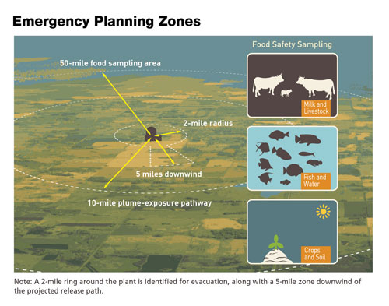
Emergency Planning Zones (EPZ) around Nuclear Plants
Inside the EPZ, emergency services and radiation mitigation options must be made available
A 1975 study set a 10-mile standard for all plants
But new reactors designs (SMRs) that are smaller and safer. Do they get smaller EPZs?
Choice …
  10-mile distance
  Worst-case distance
  “Scalable” EPZ
Use PRA-determined distance to be
95% sure that no one outside the zone gets more than 1 REM given an event

Slide 20
Risk Distributions
Vary with Distance
Dose
Wider spread and longer tails
with greater distance
PAG
5 Rem
PAG
1 Rem
95th
Median
5th
2 miles
4 miles
7 miles
Distance
How well are the distributions understood?
Uncertainty about uncertainties?

Slide 21
Not All Risk-Mitigation Schemes
(i.e., Regulations) Are Created Equal
Opportunity Costs per Statistical Life Saved
“REGULATION OF HEALTH, SAFETY AND ENVIRONMENTAL RISKS” Kip Viscusi 2006

Slide 22
Example for Sharing Spectrum
Proposal to share spectrum for geographically sparse users
Interference likelihood uncertain
Determining the threshold probability for interference
Calculate “expected utility” for all four outcomes
No
Interference
Interference
Allow
Sharing
Improved
service
Real
problem
Block
Sharing
Missed
opportunity
Avoided major
problems

Slide 23
What Comparisons Can Be Made?
Compare the outcomes
  Best outcome: Allow Use/No Interference
  Lost opportunity: Block Use/No Interference
  Avoided problem: Block Use/Interference
  Worst outcome: Allow Use/Interference
For each pair of outcomes
  Which is better?
  How much better?
Between pairs
  How different are the differences?
The difference of the differences determines the threshold probability

Slide 24
Determine the Threshold Probability
Probability Threshold
Improved service
Block Use
Avoided problem
Lost opportunity
Allow Use
Expected Value
Real problem
0
0.5
1.0
Definitely
interference
Definitely
no interference
Probability of Interference

Slide 25
Determine the Threshold Probability
Probability Threshold
Improved service
Allow Use
Avoided problem
Real problem
Lost opportunity
Block Use
Expected Value
0
0.5
1.0
Definitely
interference
Definitely
no interference
Probability of Interference

Slide 26
Precautionary Situation
(LightSquared?)
Probability Threshold
Improved service
Block Use
Avoided problem
Lost opportunity
Allow Use
Expected Value
Real problem
0
0.5
1.0
Definitely
interference
Definitely
no interference
Probability of Interference

Slide 27
Conclusions
Embrace risk
  It’s there, exploit it
  Other sectors of the economy have
Risk and regulation are strange bedfellows
  How much risk aversion is rational
  Who pays? Who benefits? When? How?
  How are bad-luck losers compensated (if at all)?
Poorly done risk analysis … what could go wrong?
Those darn unintended consequences!

