Slide 1
From the Public Switched Telephone Network to the Public Digital Communications Network: The Role of Interconnection, Interoperability, Universal Service and Innovation at the Edge in the Digital Revolution Mark Cooper Interconnection Policy for the Internet Age, The Digital Broadband Migration: The Future of Internet-Enabled Innovation, Silicon Flatirons, February 10-11, 2013

Slide 2
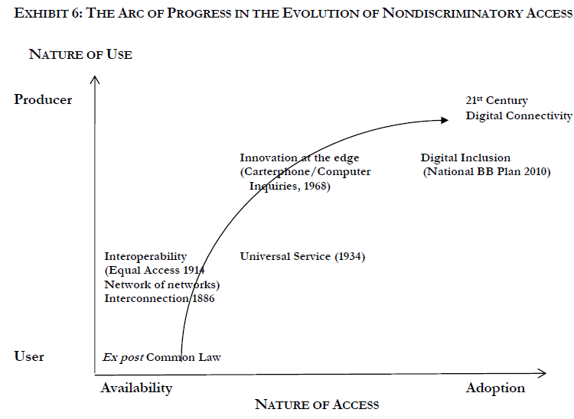

Slide 3
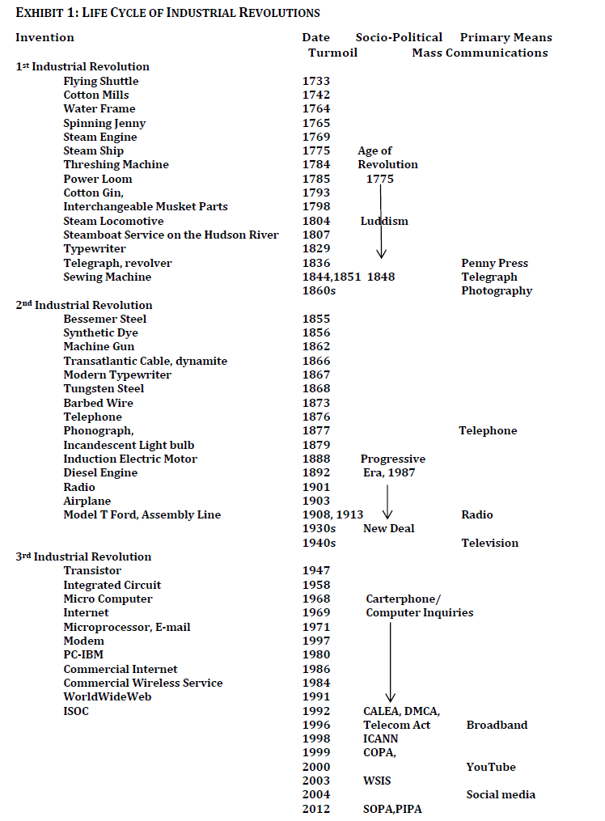

Slide 4
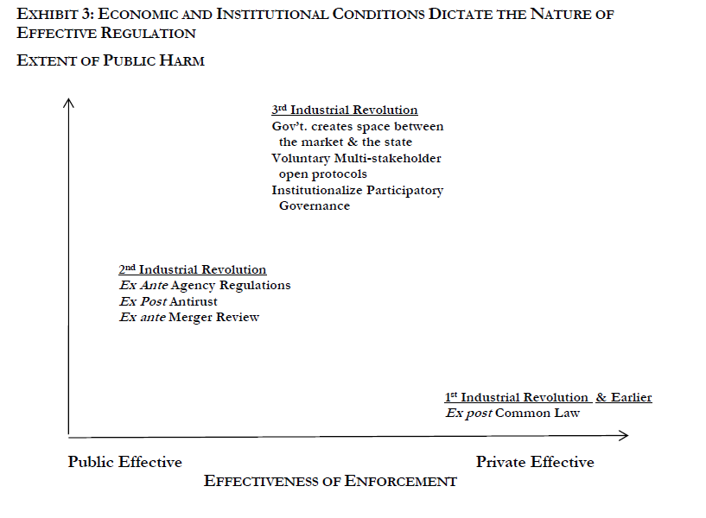

Slide 5
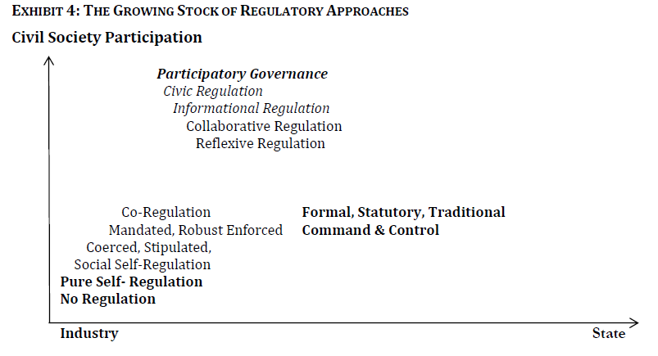

Slide 6
