Slide 1
Bottlenecks on the Internet and Platform Competition
Susan Athey, Stanford University and Microsoft Research
Disclosure: The author consults for Microsoft.

Slide 2
Questions
How do data and information affect platform competition and create competitive “bottlenecks”?
What is the role of economies of scale and network effects?
Does platform competition among firms, each of which has a substantial market share in some products, eliminate the importance of bottlenecks?
What are the motivations for vertical integration in platform competition?
How do the big internet device, search and online advertising platforms affect internet publishing, innovation, and the markets for online services?

Slide 3
Device Platforms
Multi-sided markets
Referrals and bottlenecks
Vertical integration

Slide 4








Platform Competition and Innovation

Slide 5
Online Services & Content
Search
Browser
Search
Apps
OS
Device

Slide 6

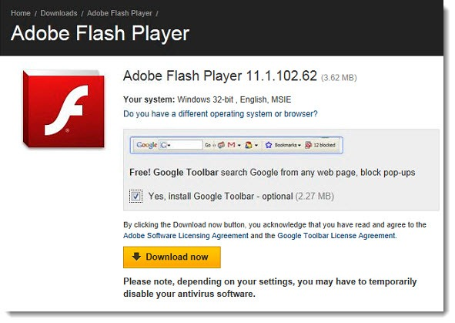



Antitrust and the Browser Wars, Revisted

Slide 7
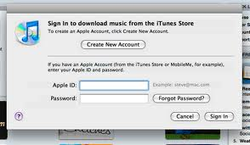


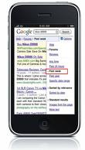


Mobile Platforms

Slide 8



Online Services & Content
Google Services, Cloud, App Store
Retail/Content/ App Stores;
Cloud storage
iTunes; iCloud;
App Store
Search
Search
Search
Browser
Search
Browser
Search
Browser
Search
Apps
Apps
Apps
OS
OS
OS
Device
Device
Device

Slide 9
Case Study: Internet Search
Multi-sided markets
Economies of scale and data
Referrals on the internet and bottlenecks

Slide 10
Search: Multi-sided markets, economies of scale and competition
Search users
More relevant
algorithmic results
More
advertisers
More data
Advertisers
More innovation, more investment, more users
More relevant ads, higher revenue per search
More innovation,
better user
experience
Partners and Websites
More
syndication
partners
More traffic and
revenue for
ecosystem partners
More data, better publisher-side algorithms
Publishers

Slide 11



Search is Concentrated
Query Volume Share
United States
Worldwide
Other
1.5%
+
+
8%
29.6%
70.4%
90.5%
*March 2011 comScore figures (includes search partners)
* March 2011 Statcounter global statistics (includes search partners)
11

Slide 12
Paid Search is Concentrated (U.S.)
U.S. Paid Search Share
Google
Yahoo!
Microsoft
Other (Overture)
12

Slide 13










Bottlenecks, Referrals, and Vertical Integration
Users
Device UI: PC, Mobile, Tablet, Gaming, TV
Browser
Online Content
Cloud Services
Advertisers
Travel

Slide 14
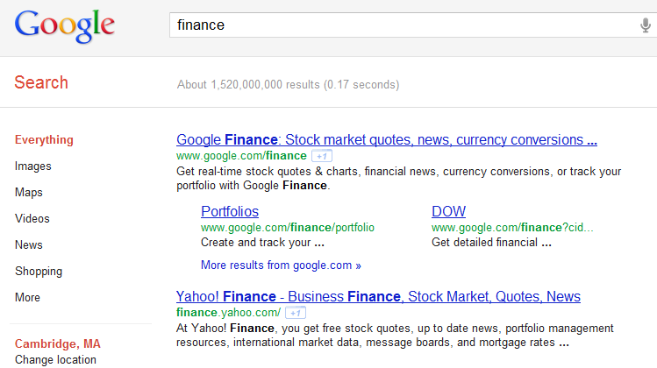
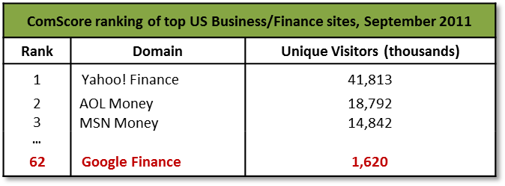
Manipulation and Innovation
Defensive Strategies for Dominant Firm
Vertical integration
Make your own service the winner through prominence
Strategies for Competing Firm
Partner with others
Always choose the best partner to improve your user experience
Innovate in verticals
Impact on Industry
Incentives for entrepreneurship and innovation

