Slide 1

Leveraging Technology for Efficiency and Productivity
Mark Chandler
Senior Vice President, General Counsel and Secretary

Slide 2

The Best Job in the World
Visionary Leadership
Cool toys
Smart customers
Whole new world

Slide 3
Today’s Agenda
What Drives Us
Our Department and our Framework
Contrasting Perspectives
Aligning Vision; Strategy; and Execution
Three-Pronged Solution

Slide 4

Cisco Legal is Mission-Driven
Enduring Values
Ensure transparency and integrity
Be change agents
Low cost, high quality legal department; leveraging people and technology
Partner with our clients
Notes:
4

Slide 5
Core/Context Strategy
Context Activities that are necessary but not tied to competitive advantage
Core Activities that contribute to competitive advantage
Mission Critical
Activities that, if performed poorly, pose an immediate risk
Out-task
In-task
High-stakes litigation
Reputation
Compliance
HR policy
Design, build and sell
Business development
Intellectual property rights
Non-Mission Critical
Activities that, if performed poorly, do not pose a risk
Outsource
Self-Service
HR cases
Smaller litigation
Real estate
Routine transaction processing
Notes:
5

Slide 6
Benchmarking Total Legal Expense as % of Revenue
Assumptions for FY12:
Cisco Revenue Growth to $45.7B
Legal Spend of $193M (COGS and OPEX)

Slide 7
Today’s Agenda
What Drives Us
Our Department and our Framework
Contrasting Perspectives
Aligning Vision; Strategy; and Execution
Three-Pronged Solution

Slide 8


Cisco Legal Services

Slide 9

Cisco Legal Services
200 attorneys worldwide
56 additional professionals
7 administrative assistants
17 paralegals
206 primary outside law firms
Notes:
My primary customer

Slide 10
The Job: Prevent Global Chaos
Cultures
Markets
Languages
Laws
Territories
Policies
Finances
Customers
Technologies
Markets
Notes:
At a macro-level, my job is prevent global chaos at an operational level.

Slide 11
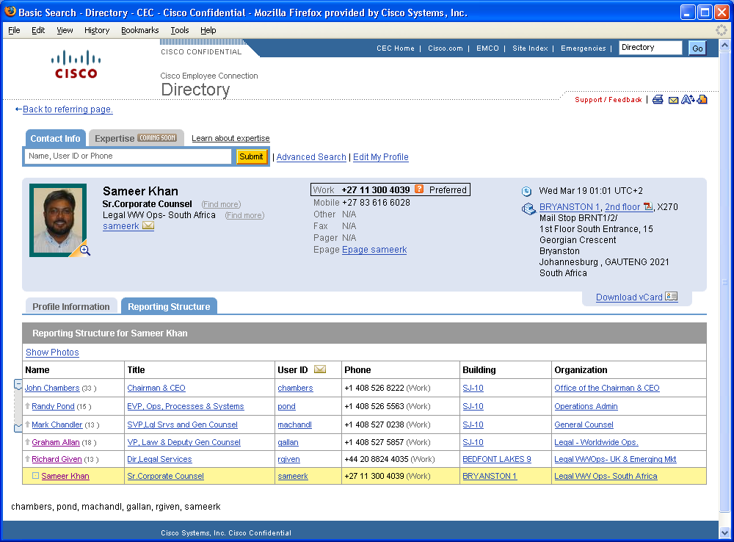

To put it in perspective
Sameer is the South Africa
Cisco Legal Team.
Johannesburg

Slide 12
Today’s Agenda
What Drives Us
Our Department and our Framework
Contrasting Perspectives
Aligning Vision; Strategy; and Execution
Three-Pronged Solution

Slide 13
Law Firm Normal v. Enterprise Normal
More is
better
Better is
better
“If it ain’t
broke”
Prices go
up
“Somewhere
a 26-yr old”
Prices go
down
INSIGHT
INFORM-
ATION
“How always
been done”
Can’t
measure
“How can we
do better?”
Everything
measured
Fear:
Cross the
line
Fear: China
Competitor

Slide 14
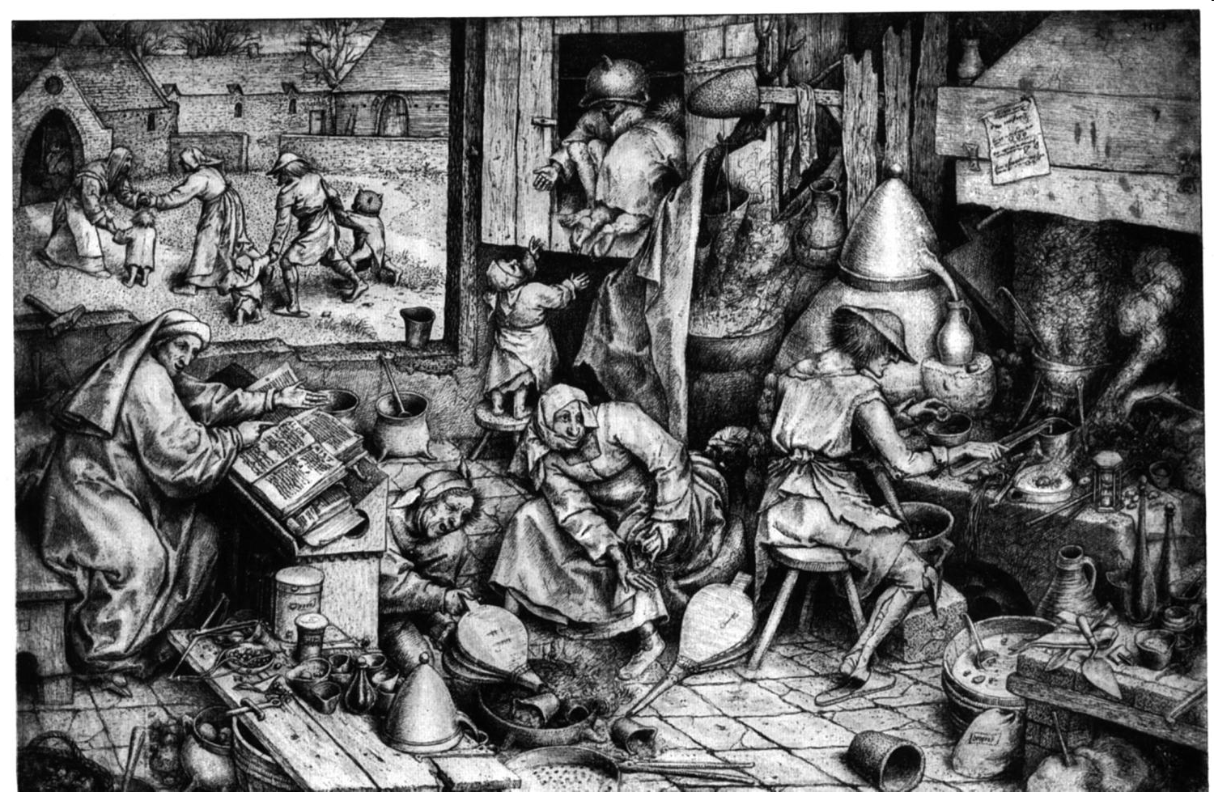
Medieval Guilds Not Likely To Survive

Slide 15
Today’s Agenda
What Drives Us
Our Department and our Framework
Contrasting Perspectives
Aligning Vision; Strategy; and Execution
Three-Pronged Solution

Slide 16



STRATEGY
Extensible platforms to maximize agility
One-to-many knowledge dissemination
“Service org to a service org” mindset
Evolve core competency from “utility makers” to “internal consultants”
VISION
Enable the business with productivity-enhancing tools, processes, and operating models that maximize attorney efficiency, client-side self-service, and responsiveness to sales operations
2-4 Years
Extend Core v. Context to application layer
Build when necessary; favor configuration and deployment
Cross-functional data hub
Under-promise and over-deliver; keep program commitments
EXECUTION
5+ Years
12-18 Months

Slide 17
Agility: ability to respond to...
STRATEGY
Market adjacencies
Acquisitions
Anti-corruption/due diligence
Controls
Localization
New Cisco entities
Globalization
Complexity
Unknowns …
Extensible platforms to maximize agility
2-4 Years

Slide 18
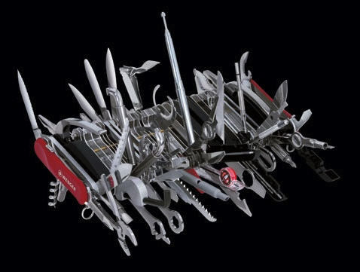
This is not agility!

Slide 19
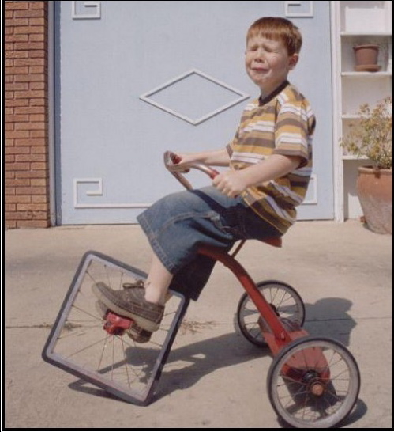
Trying harder is not the solution

Slide 20
Today’s Agenda
What Drives Us
Our Department and our Framework
Contrasting Perspectives
Aligning Vision; Strategy; and Execution
Three-Pronged Solution

Slide 21

From strategy to execution
Tools
Process
Culture

Slide 22
From strategy to execution
Tools
Notes:
When we talk about collaboration, we really are talking about three different things: a portfolio of technologies; new business processes based on collaborative business architecture; and a cultural shift to adapt to the process change and to the adoption of the new technologies.
In this paradigm, early is often preferable to elegant. We build the infrastructure, we deploy the processes, we figure out what works and what doesn't, and then we feed all of that learning back into the solution development process for the next generation of technology.
Define success prior to identifying the tool
“Be Measurable”
Create the user guide first; begin with org adoption
“No new clubs”

Slide 23
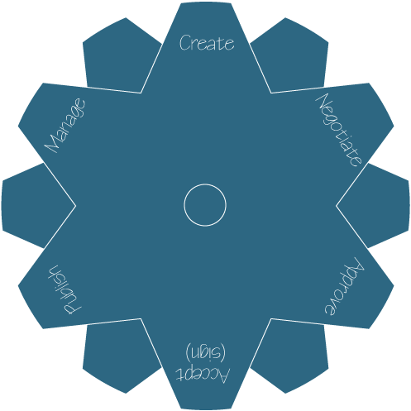
Top-Level Capabilities & Tools
Self Service
Auto-templates
Auto letters
TelePresence
Playbook
OnRamp Exchange
WebEx
VAP
Light workflow
Click Accept
Documentum
Contract Data Store
Search
Auto-renew
Auto-notifications

Slide 24

Succeeding Generations— New Technologies
Communicate
Share
Network
E-Mail
Calendar
Group Scheduling
Discussion Forums
Audio Conferencing
Low Definition Video Conferencing
Teamware
Instant Messaging
Presence
Mobile/Wireless
Web Conferencing
P2P
Webcasting
High Definition, Immersive Video
Blogs and Wikis
Social Network Analysis
Social Applications
Expertise Location
Syndication (RSS)
Ad Hoc Workflow
1st Generation
2nd Generation
3rd Generation

Slide 25

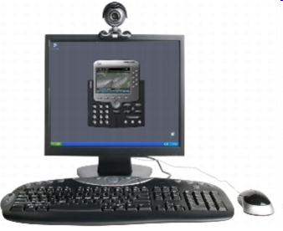
Generation 1 – Familiar Territory
Communicate
E-Mail
Calendar
Group Scheduling
Discussion Forums
Audio Conferencing
Low Definition Video Conferencing
1st Generation

Slide 26
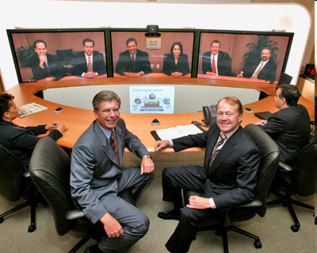
Generation 2
Share
Teamware
Instant Messaging
Presence
Mobile/Wireless
Web Conferencing
P2P
Webcasting
High Definition, Immersive Video
2nd Generation

Slide 27
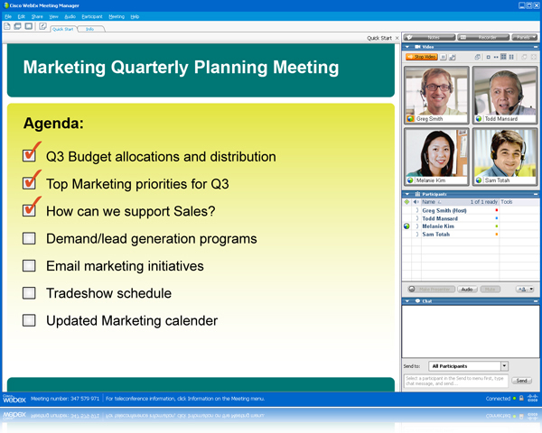
Generation 2
Share
Teamware
Document Management
Instant Messaging
Presence
Mobile/Wireless
Web Conferencing
P2P
Webcasting
High Definition Video
2nd Generation

Slide 28
Addressing the 3rd Wave
Legal internal
(secure, privileged)
Legal to internal client
(secure, privileged)
Legal to firm (privileged)
Legal to peer departments
(open)
Network
Blogs and Wikis
Social Network Analysis
Social Applications
Expertise Location
Syndication (RSS)
Ad Hoc Workflow
3rd Generation

Slide 29
From strategy to execution
Process

Slide 30
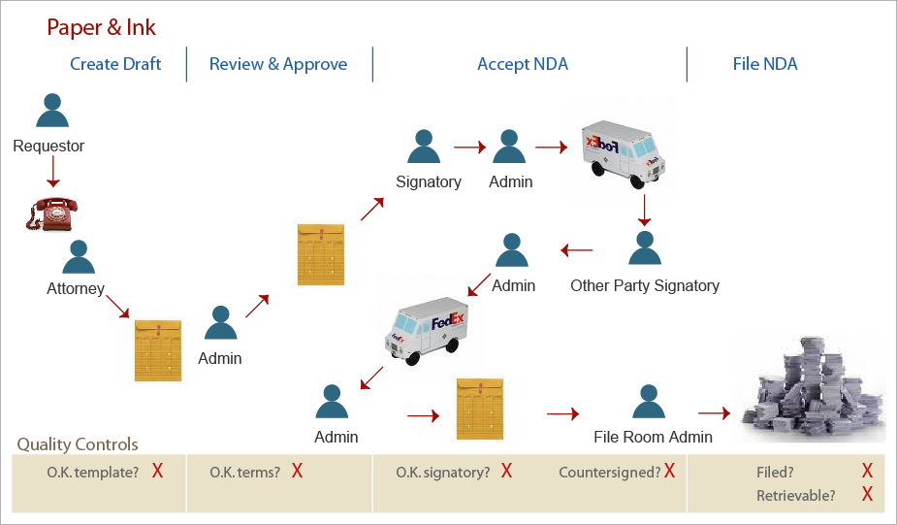
NDAs: before

Slide 31
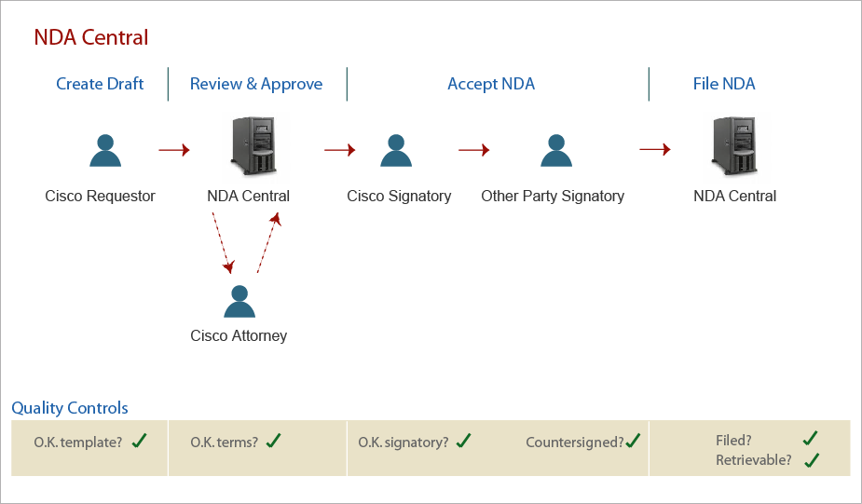
NDAs: after

Slide 32
From strategy to execution
Culture

Slide 33

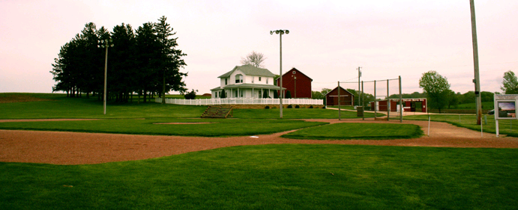
False hopes…
Notes:
If you build it they may not come… but you’ll definitely have support and maintenance costs!

Slide 34
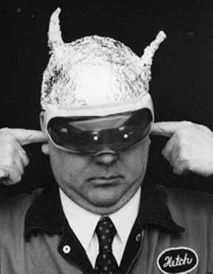
Cisco: Out there or Bellwether?
Notes:
With these prefatory comments, I’d now like to focus the rest of the discussion on the the framework we use to evaluate potential opportunities and where I believe the market is going.

