Slide 1
SOPA & PIPA: The Bills and the Debate
Paul Ohm
University of Colorado Law School
Silicon Flatirons

Slide 2
The Problem
Reproduction and distribution of copyrighted works without license over the Internet.
Bittorrent and Bittorrent trackers
Lockering services
Current legal/technical solutions may be insufficient to address.
Services hosted outside US: “Rogue websites”
Little leverage on intermediaries (search engines, ad networks, payment processors).

Slide 3
PIPA
“Preventing Real Online Threats to Economic Creativity and Theft of Intellectual Property Act” → PROTECT IP Act → PIPA
Introduced by Patrick Leahy (D-VT) 5/12/2011, eventually with forty co-sponsors
Rewrite of Combating Online Infringement and Counterfeits Act (COICA) from prior term.

Slide 4
SOPA
H.R. 3261, the “Stop Online Piracy Act”
Introduced by Lamar Smith (R-TX) 10/26/2011, eventually with 31 co-sponsors
Focus here on the “manager’s amendment” proposed 12/11/2011

Slide 5
SOPA Section 102
Attorney General empowered to proceed in rem against “foreign infringing site” or “foreign domain name used by such site” for injunction/court order against domestic providers.
DNS providers
Search engines
Payment network providers
Advertising services

Slide 6
SOPA Section 102
Representative language of obligation:
Against DNS providers:
“A [DNS] service provider shall take such measures as it determines to be the least burdensome, technically feasible, and reasonable means designed to prevent access by its subscribers located within the United States to the foreign infringing site that is subject to the order. Such actions shall be taken as expeditiously as possible.”
SOPA section 102(c)(1)(A)

Slide 7
SOPA Section 102
Narrow opportunity for recipient to seek modification/vacation of order if
“improvidently adjudicated”
“compliance . . . would impair the security or integrity of the DNS or of the system or network . . .”
“interests of justice otherwise require”

Slide 8
SOPA Section 103
Private copyrights holders empowered to proceed in rem against an “Internet site dedicated to theft of U.S. property” for injunction/court order against similar providers.
Narrow opportunity to seek modification/vacation of order
“improvidently adjudicated”
“interests of justice otherwise require”

Slide 9
Other Stuff
New/expanded crimes for
video streaming
Trafficking in counterfeit marks

Slide 10
For and Against
In support
MPAA, RIAA, US Chamber, BSA
Many others from content industry, artist groups
Opposed
AOL, eBay, Facebook, Google, Mozilla, PayPal, Reddit, Twitter, Wikimedia Found., Yahoo!, Zynga
ACLU, CDT, EFF, Public Knowledge
Source: netcoalition.com
Pulled support
GoDaddy
Entertainment Software Assn

Slide 11

The Backlash and Debate
November 16, 2011: “American Censorship Day”
Notes:
BoingBoing, Metafilter, Reddit, Mozilla, CDT, Techdirt

Slide 12
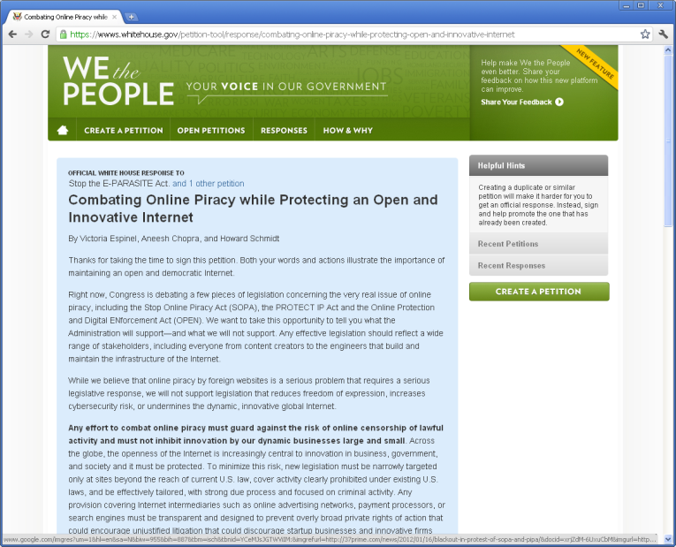
January 14, 2012
Notes:
we will not support legislation that reduces freedom of expression, increases cybersecurity risk, or undermines the dynamic, innovative global Internet

Slide 13

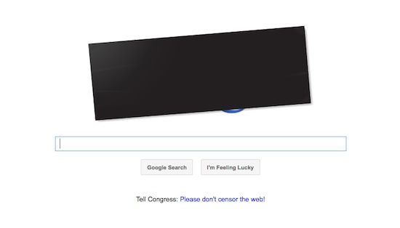
January 18, 2012

Slide 14
Fallout
Massive e-mail/phone campaign.
January 20, 2012
Lamar Smith: “The House Judiciary Committee will postpone consideration of [SOPA] until there is wider agreement on a solution.”
Tweet from @senatorreid
“In light of recent events, I have decided to postpone Tuesday's vote on the PROTECT IP Act #PIPA”

