Slide 1
Why Growing Up is Hard to Do:
The “Quarter-life Crisis” of the Digital Revolution triggers
a Struggle to Find 21st Century Solutions to 21st Century Challenges
Mark Cooper,
Adjunct Fellow, Silicon Flatirons
2011

Slide 2
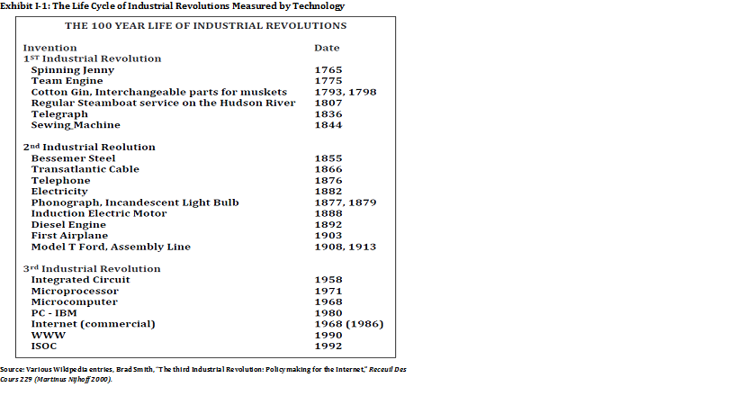

Slide 3
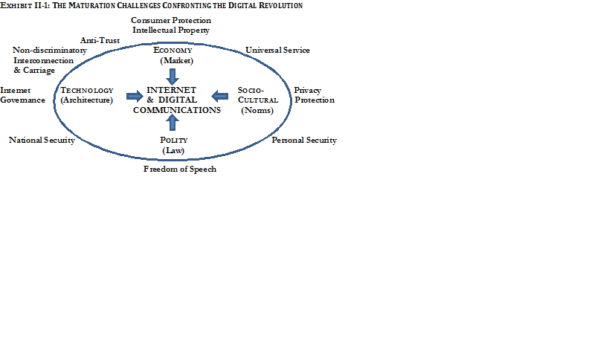

Slide 4
Exhibit II-2: The Political Economy of Social Order defined by the Nature and Value of Institutions in the Society
_____________________ Realms of Social Order ___
Technology Economy Socio-Cultural Polity
Institutional Elements
Value Created Comfort/ Well-being Fulfillment Freedom
Security Equity Dignity, Self-awareness Autonomy, Agency
Affected Activity Movement Exchange Self-Expression Speech
Creation of Meaning Mobilization
Measure of Progress Expanding the Improving Enabling fulfillment Expanding the
range of things material character development sphere of freedom humans can do well-being & & connectedness; Increasing individual
by reducing distributing Enhancing the ability to autonomy/action and
constraints & it justly to self-consciously facilitating collective
increasing produce the cultural translation into
affordances artifacts that create authority
shared meaning
Modality of Regulation Architecture Property rule Norms – Meaning Law
Roles Governed Inhabitant/ Consumer/ Person/ Citizen/
User Producer Member People
Primary Institution Place/Space Enterprise/ Family/Church State/Media
Union
Enforcement Agents Builder/ Seller/Buyer Peers/Group Police/Courts
Operator
Nature of Constraint Physical Monetary Opprobrium Sanction
Timing of Constraint Before During Before/After After

Slide 5
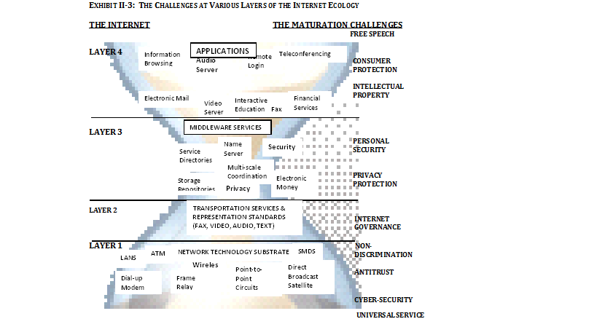

Slide 6
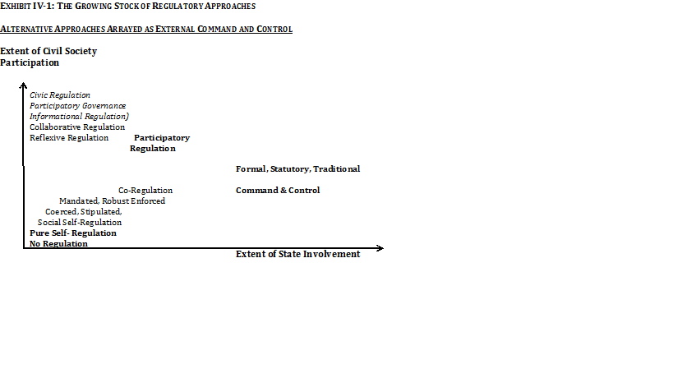

Slide 7
